Slide 1
University of Tennessee January 26, 2023 Bonnie P. Britton, MSN, FATA, CEO

Slide 2
Learning Collaborative Goals
Explore Remote Patient Monitoring (RPM) best practices.
Discuss components of CMS RPM billing
Learning Collaborative will be held over 2 sessions
Two 1 hour sessions
After session work between sessions 1 and 2
© R4H 2021
Notes:
Slides 1-

Slide 3
Remote Patient Monitoring
Patients collect bio-metric data remotely & data is transmitted for review.
Patient bio-metric data includes:
Weight
Blood Pressure
Heart Rate
Pulse Oximetry
Glucometer
Temperature
PFTs
Patients with acute and chronic condition(s).
© R4H 2021

Slide 4
RPM Value Proposition
Analyze trended data over time.
Provide care between episodes of care.
Educate, engage and empower patients in their health and wellbeing.
Detect early signs of disease exacerbations.
Increase access to care.
© R4H 2021

Slide 5
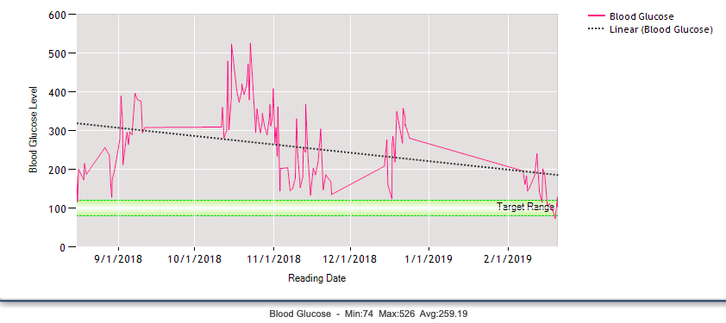
Disease Management – Data Trends
© R4H 2021
Results: DM Glucose Control

Slide 6
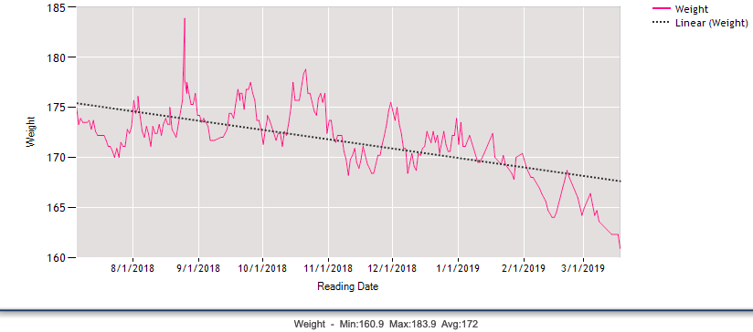
Disease Management: Data Trends
© R4H 2021
Results: Heart Failure Weight Control

Slide 7
RPM Program Goals
Increase access to care
Increase patient engagement
Improve clinical outcomes
Improve patient experiences
Decrease hospitalizations
Decrease ED visits
© R4H 2021
Notes:
Do we want to introduce SMART goals?

Slide 8
RPM Patient Populations
Heart Failure
Hypertension
COPD
Diabetes
Kidney Disease
Asthma

Slide 9
Selection Criteria
Inclusion Opt In
Exclusion
Unable to use devices (cognitive and/or physical limitations.)
Refuse to consent to participate.
Unable or unwilling to communicate with care team.
Notes:
Do we want to introduce SMART goals?

Slide 10
Patient Identification, referral, enrollment and installation workflow
Who is the best person(s) to:
Identify patients?
Contact/meet patients to explain program and obtain verbal consent?
Enter information into software platform?
Provide devices?
Train patients?
Competency validate patients?
© R4H 2021

Slide 11
Patient Monitoring, Validation & Escalation Clinical Workflow
Who is going to:
Monitor alerts?
Call patient and validate alerts?
Conduct nursing assessment & provide patient education?
Escalate to medical provider for possible medical intervention?
Hours for monitoring patients
© R4H 2021

Slide 12
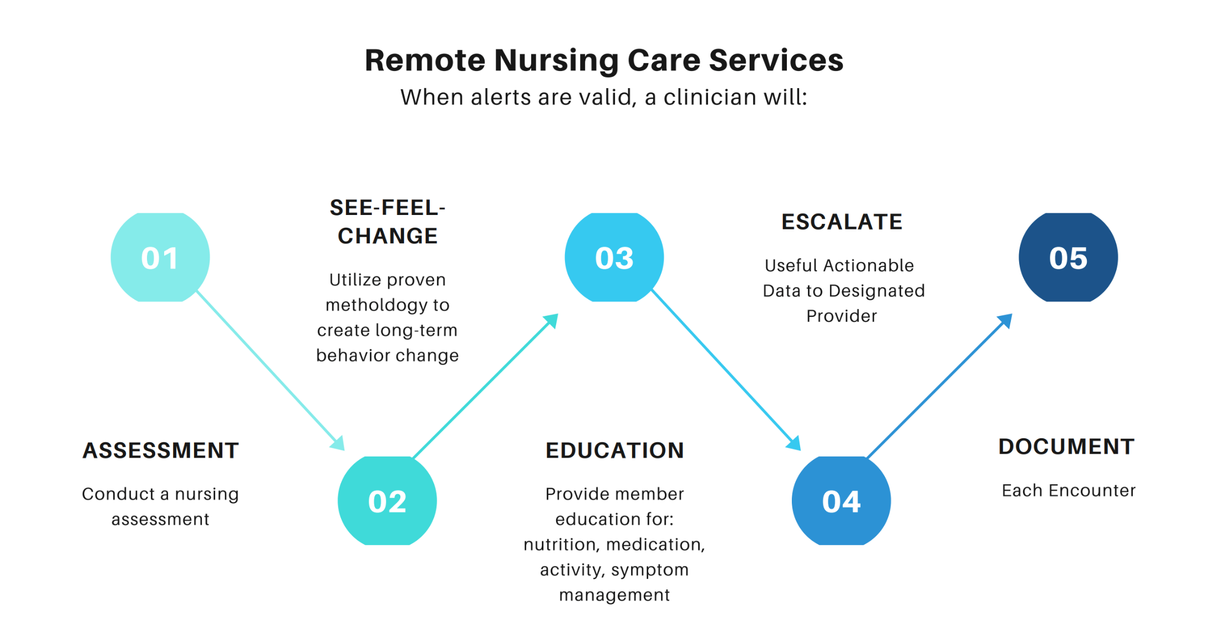

Slide 13
Discharge Workflow
Discharge criteria
Will devices be returned and refurbished?

Slide 14
Device Management
Inventory
Storage
Pulling for patients
Patient education
Device tracking

Slide 15
Question and Answer Session

Slide 16
RPM Assignment
Patient Identification, referral, enrollment and installation workflow
Patient Monitoring, Validation & Escalation Clinical Workflow
Patient Discharge Workflow

Slide 17
Contact Information
Bonnie Britton
bbritton@reconnect4health.com
252-287-6666
© R4H 2021

