Slide 1
Teaching the Teachers: Peer Review as a Tool for Growth and Innovation
Kristen Bettin, MD, MEd
Elisha McCoy, MD

Slide 2
Objectives
Describe the purpose and benefits of peer review in the context of health professions education.
Identify key components of an effective peer review process.
Compare and contrast peer review frameworks or models used in health professions education.
List strategies to implement or enhance peer review practices within your own program or college.

Slide 3
Set up: Give peer feedback during the following video

Slide 4
Video (yet to find)

Slide 5
Why perform peer review?
Provides formative feedback to educators from other educators
Bidirectional opportunity for improvement through peer coaching and mentoring
May be required for Promotion and Tenure

Slide 6
Frameworks for Peer Review
The Westerveld Framework
Situation – Behavior - Impact
Start, Stop, Continue
iSPOT

Slide 7
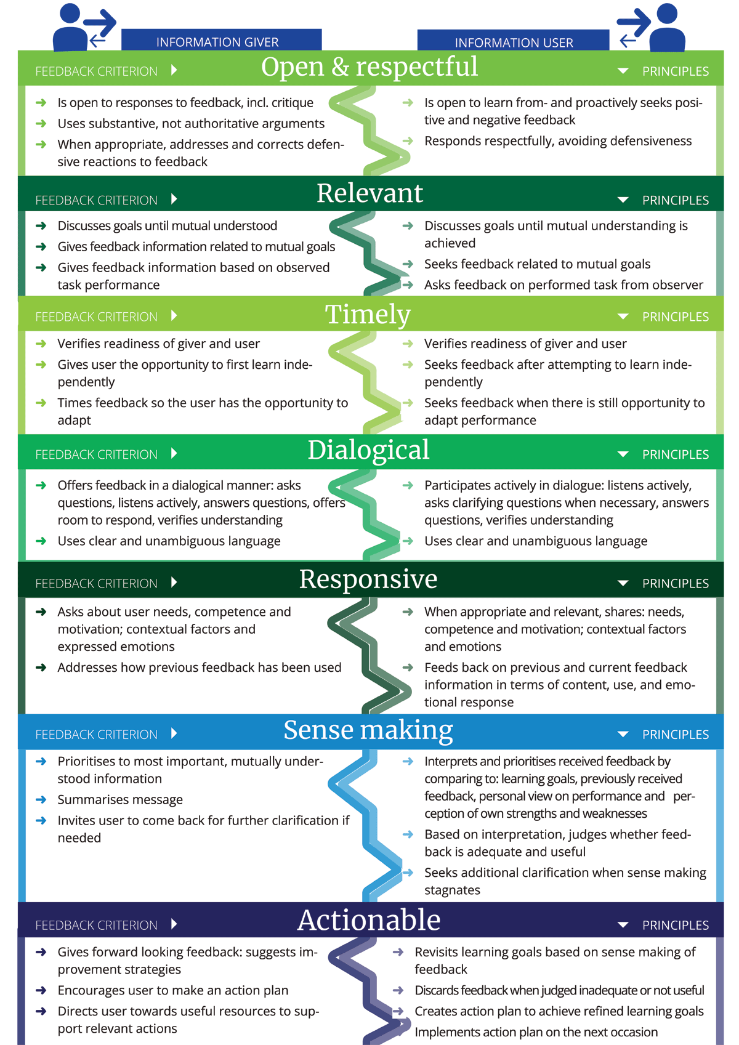
Westerveld Framework
Open & respectful
Relevant
Timely
Dialogical
Responsive
Sense Making
Actionable
Tielemans, C., de Kleijn, R., van der Schaaf, M., van den Broek, S., & Westerveld, T. (2021). The Westerveld framework for interprofessional feedback dialogues in health professions education. Assessment & Evaluation in Higher Education, 48(2), 241–257. https://doi.org/10.1080/02602938.2021.1967285
Tielemans C, de Kleijn R, van der Valk-Bouman E, van den Broek S, van der Schaaf M. Preparing Medical and Nursing Students for Interprofessional Feedback Dialogues. Perspect Med Educ. 2023 Oct 31;12(1):472-479. doi: 10.5334/pme.1069. PMID: 37929205; PMCID: PMC10624133.

Slide 8
Open & Respectful
Information Giver
Information User
Open to responses to feedback, including critique
Uses substantive, not authoritative arguments
When appropriate, addresses and corrects defensive reactions to feedback
Open to learn from and proactively seeks positive and negative feedback
Responds respectfully, avoiding defensiveness

Slide 9
Relevant
Information Giver
Information User
Discusses goals until mutual understanding achieved
Gives feedback information related to mutual goals
Gives feedback information based on observed task performance
Discusses goals until mutual understanding is achieved
Seeks feedback related to mutual goals
Asks feedback on performed task from observer

Slide 10
Timely
Information Giver
Information User
Verifies readiness of giver and user
Gives user opportunity to first learn independently
Times feedback so the user has the opportunity to adapt
Verifies readiness of giver and user
Seeks feedback after attempting to learn independently
Seeks feedback when there is still opportunity to adapt performance

Slide 11
Dialogical
Information Giver
Information User
Offers feedback in a dialogical manner: asks questions, listens actively, answers questions, offers room to respond, verifies understanding
Uses clear and unambiguous language
Participates actively in dialogue: listens actively, asks clarifying questions when necessary, answers questions, verifies understanding
Uses clear and unambiguous language

Slide 12
Responsive
Information Giver
Information User
Asks about user needs, competence and motivation; contextual factors and expressed emotions
Addresses how previous feedback has been used
When appropriate and relevant, shares needs, competence and motivations; contextual factors and emotions
Feeds back on previous and current feedback information in terms of content, use, and emotional response

Slide 13
Sense making
Information Giver
Information User
Prioritizes to most important, mutually understood information
Summarizes message
Invites user to come back for further clarification, if needed
Interprets and prioritizes received feedback information
Based on interpretation, judges whether feedback is adequate and useful
Seeks additional clarification when needed

Slide 14
Actionable
Information Giver
Information User
Gives forward looking feedback: suggests improvement strategies
Encourages user to make an action plan
Directs user towards useful resources to support relevant actions
Revisits learning goals based on feedback
Discards feedback when judged inadequate or not useful
Creates action plan to achieve refined learning goals
Implements action plan on next occasion

Slide 15
Situation – Behavior – Impact (SBI)
Situation
Behavior
Impact

Slide 16
SBI Model
S
Describe the Situation
Be specific. The goal is for the receiver to be clear about the time, place, and circumstances.
B
Describe the observable behavior. Keep it simple and descriptive.
Here’s what I saw and/or heard – what a video would capture
Avoid judgement. Do not talk about what you assume the other was thinking, or the motivation for the behavior.
I
Impact on you – what you thought and/or felt.
Impact on others – how others reacted. Keep it factual.
Impact on the results of the team, project, and/or organization.
https://www.ccl.org/articles/leading-effectively-articles/closing-the-gap-between-intent-vs-impact-sbii/

Slide 17
Start – Stop - Continue
It might be a good idea to start…
I’d like you to consider starting…
I believe it would be helpful if you started…
I find it challenging when you…
It might be better if you stopped…
Give an example of how the behavior might inhibit learning.
One thing I like about your teaching is…
I think it would be helpful to continue…
Provide an example of an action to continue because it enhances learning.

Slide 18
iSPOT (Increasing and Standardizing Peer Observation in PHM teams)

Slide 19
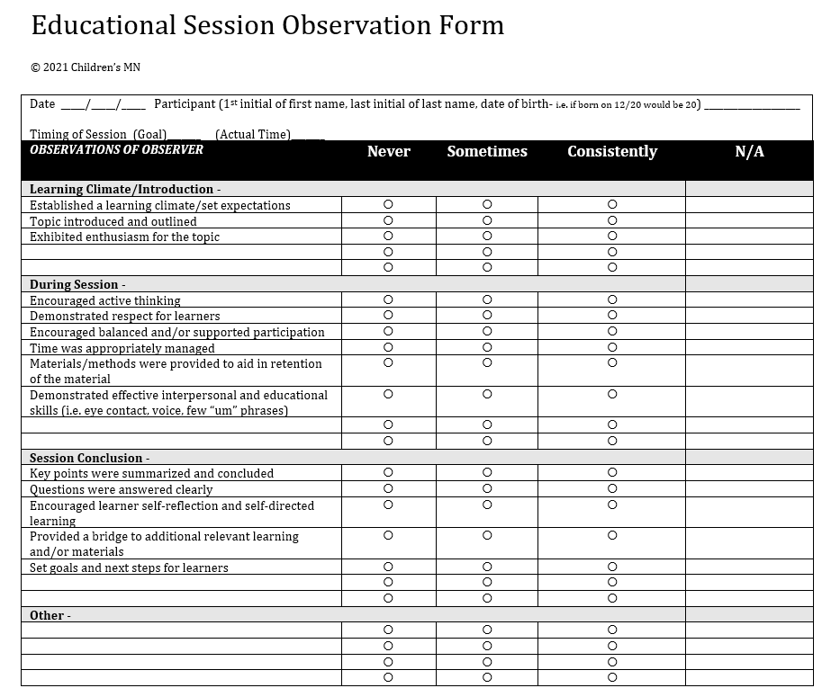
iSPOT
Educational Session Observation Form

Slide 20
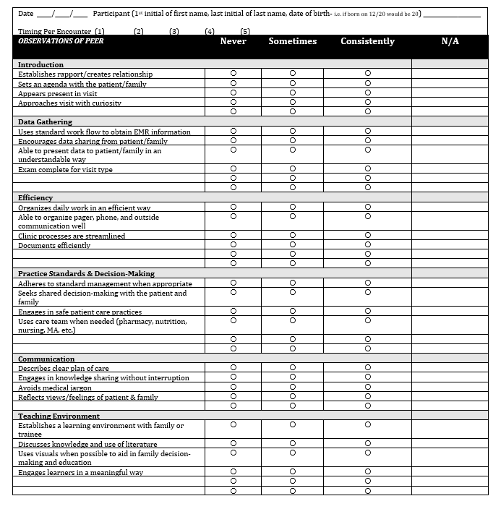
iSPOT
Clinic Observation Tool

Slide 21
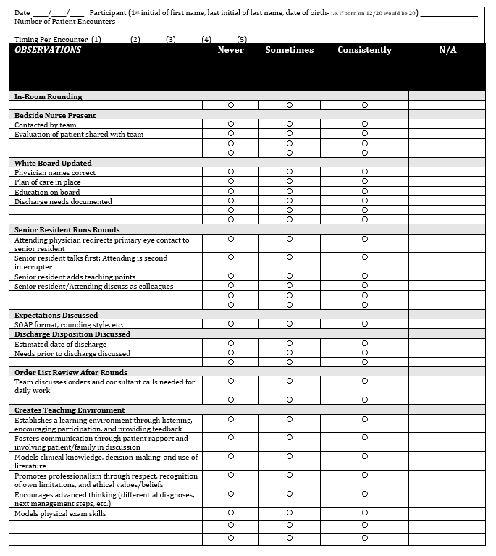
iSPOT
Rounding Observation Form with Learners

Slide 22
Let's revisit the video – How would you change your feedback to your peer?

Slide 23
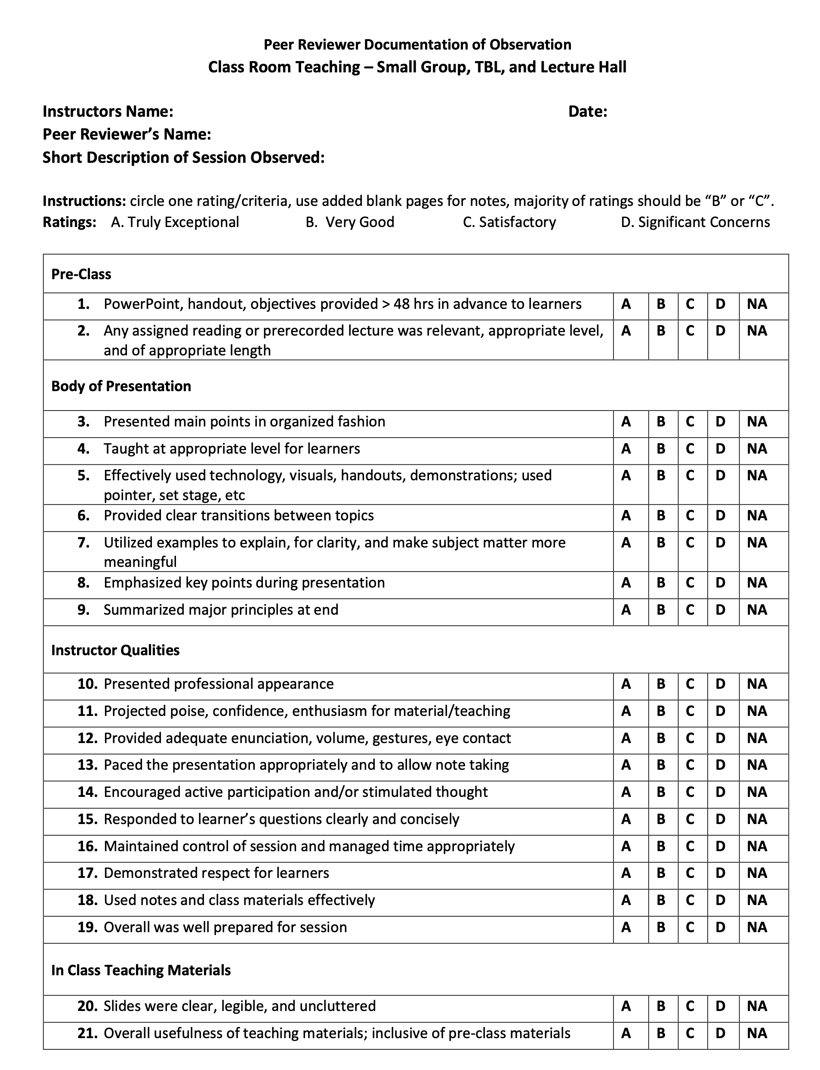
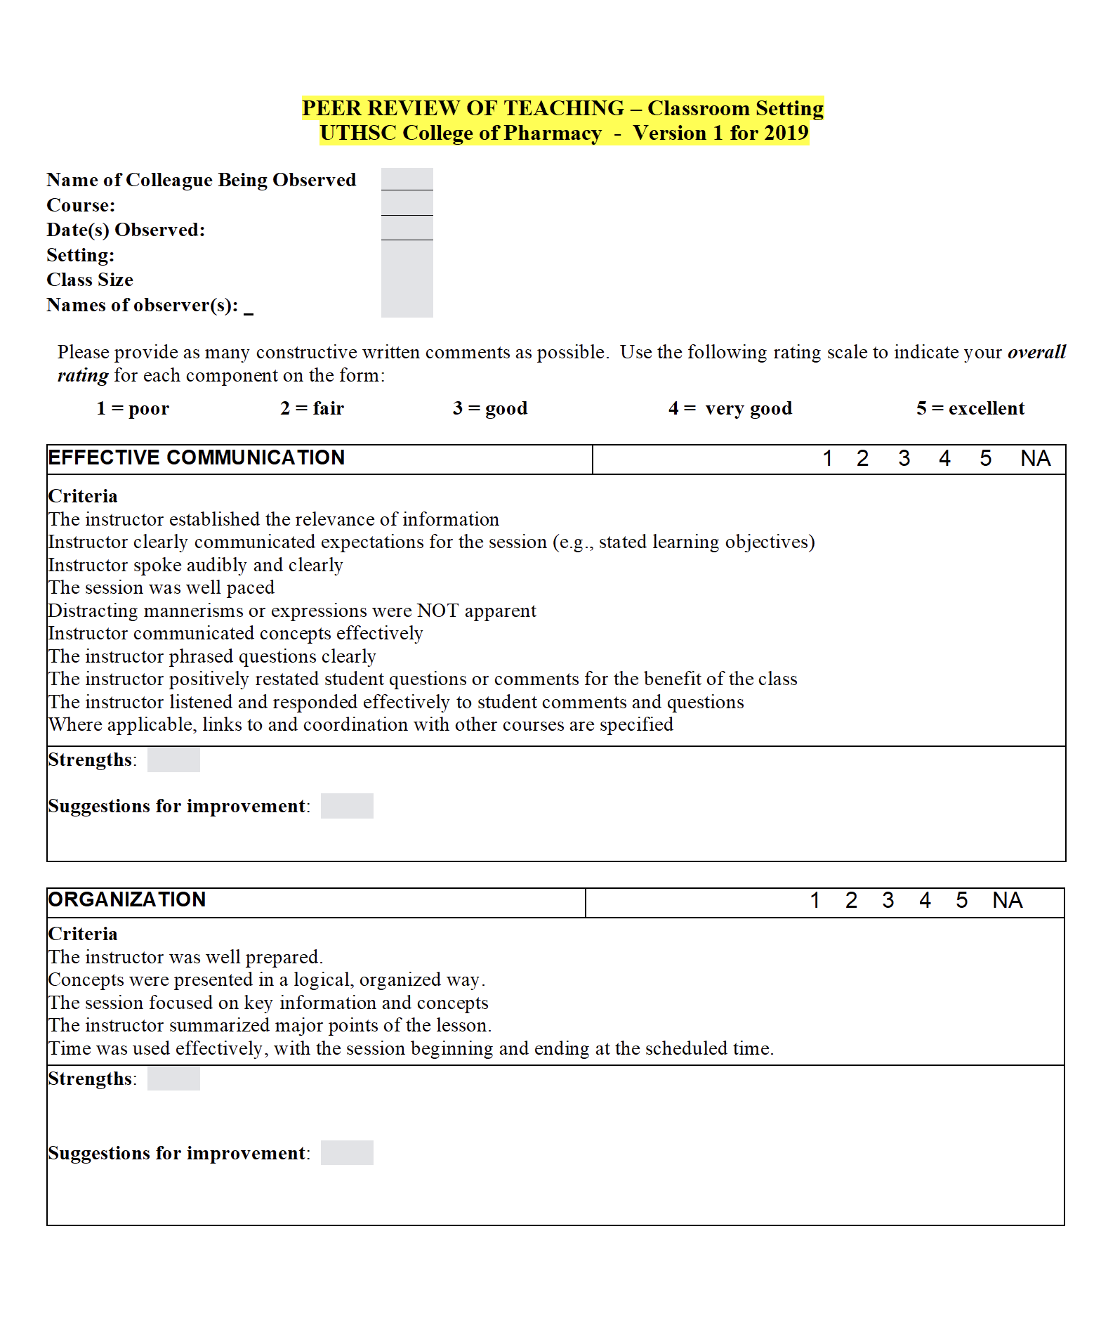
Current use of peer review of teaching
Medicine -
Classroom Setting
Clinic/Rounds Setting
Laboratory Setting
Pharmacy -
Classroom Setting

Slide 24
Future Directions and Information Sharing

Slide 25
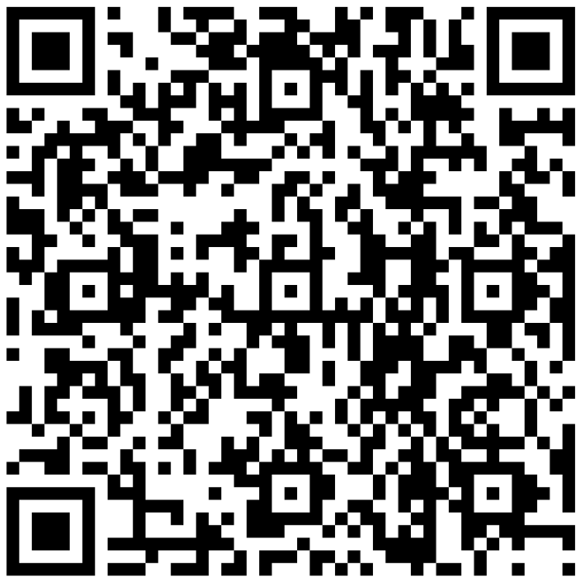
Resources

Slide 27

How to Claim Your CE Credit
1
Visit http://utcop.learningexpressCE.com and create an account or log in. If it’s your first time to our site, you’ll need to create an account. Make sure to have your NABP ePID and DOB handy!
2
When you are logged in, click on the “My Account” tab and navigate to Pending/Private Activities.
Scroll to the bottom of Pending/Private Activities and type in the access code provided to you at your session.
3
Select Register Now once you have arrived at your program's page. After registering you will then complete the evaluation for this activity.
4
Questions?
Contact our office using the “Contact Us” form on our website or give us a call at 865-974-6605. Please note that,
consistent with A CPE’s policy, University of Tennessee College of Pharmacy is unable to award or correct credit for any reason, if more than 60 days have passed from the date of the activity.
After you complete your evaluation, attendance will be cross-checked against log-in records. A report will then be sent to CPE Monitor, using the NABP ePID and DOB you have stored in your profile. (see step 1)
5
Allow up to 48 hours to see your CE credit online in your NABP Profile.

Slide 28


CPE Credit
Your private event code for this program is: HSES25084
*This will be the code you enter at the bottom of the Pending/Private Events page.

