Slide 1
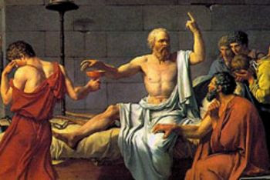
So You Think You Can Socratic?

Slide 2
Socratic Method
Claimed he knew nothing
Questioned everything
Aimed for state of confusion/doubt (aproria)
Two-way street
Open ended questions
Also used leading questions with intuitive answers
Often ended without an answer
Notes:
Athenian philosopher in 400s BCE
Claimed he “knew nothing”. Said his awareness of this was his wisdom
Questioned other people’s beliefs and views (elunchus) in an attempt to have them realize their own ignorance. State of aproria (confusion and uncertainty) that would lead to curiosity
Did not give answers – asked “leading questions” in an attempt for knowledge midwifery – knowledge is within. Usually statement of fact, then ask for agreements.
Lots of analogies and hypotheticals.
Second, the purpose of Socrates’ methods was not to instruct or to sway while he led his learners down a path in determining
the truth about an issue. The questioning by Socrates was intended to place an individual’s beliefs under scrutiny that would ultimately lead to their refutation.
Known by theGreeks as elunchus, the challenge by Socrates of a set of beliefs of his learners assessed whether they were mutually consistent. The refutation of beliefs led to a state of confusion and doubt known as aproria. Socrates’ goal of elunchus followed by aproria was to create a state of curiosity in his group of learners so as to initiate a collective search for truth through further group discussion. As such, Socrates oversaw the realization of his students in the process
of discovering truth (learning) on their own. He
believed that true knowledge lies within the learner
and is brought out by a series of questions asked in a humane
fashion within a group, a type of intellectual
midwifery whereby the delivery of truth and knowledge
occurred in the learner. In essence, the Socratic
method of teaching occurred through the development
of wisdom that began in admitting one’s own ignorance.
Self-knowledge is the ultimate virtue, and
learners will arrive at truth through questioning. The
arrival of truth occurred through working collaboratively
in groups, exploring interpretive questions that
lack a specific answer but activate

Slide 3
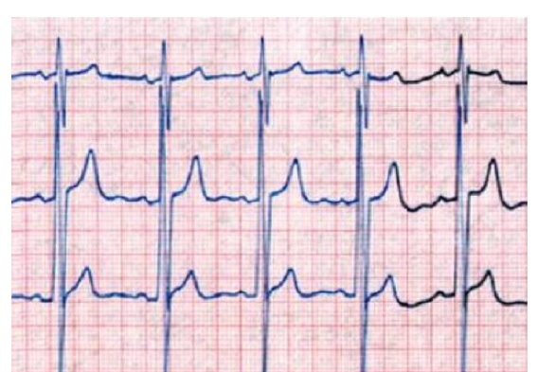

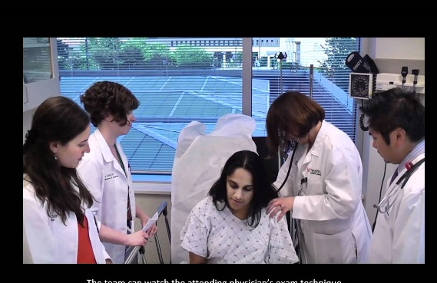
What makes a “great” teacher
Enthusiasm
Relevance
Learner autonomy
Excellence in the field
Asks good questions
Singh S, et al. BMC medical education. 2013;13(1):128.
Sutkin G, et al. Academic Medicine. 2008;83(5):452-466.
Notes:
***reference

Slide 4
Learning objective
Apply a deliberate approach to asking questions to learners in the clinical learning environment.

Slide 5
Relevant disclosures
None

Slide 6
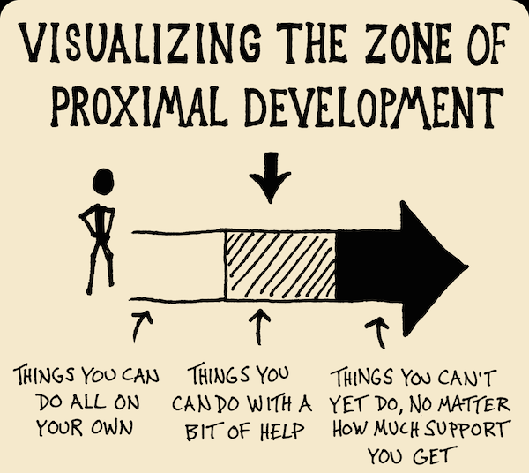
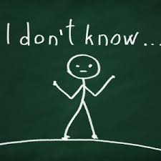
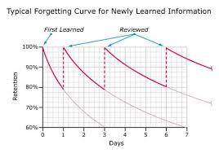
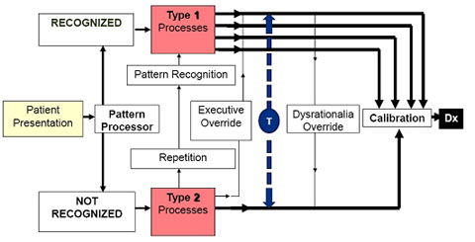
Why ask questions when teaching?

Slide 7
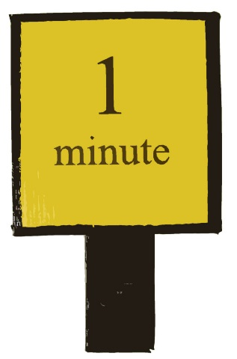
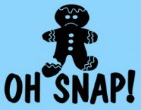
Structured Teaching Scripts
Cayley, W. E., Jr. (2011). "Effective clinical education: strategies for teaching medical students and residents in the office." WMJ 110(4): 178-181; quiz 203.
Eckstrom E, Homer L, Bowen JL. Measuring outcomes of a one-minute preceptor faculty development workshop. Journal of general internal medicine. 2006;21(5):410-414.
Furney SL, Orsini AN, Orsetti KE, Stern DT, Gruppen LD, Irby DM. Teaching the one‐minute preceptor: a randomized controlled trial. Journal of general internal medicine. 2001;16(9):620-624.
Kapoor A, Kapoor A, Kalraiya A, Longia S. Use of SNAPPS model for pediatric outpatient education. Indian pediatrics. 2017;54(4):288-290.
Pascoe, J. M., et al. (2015). "Maximizing teaching on the wards: review and application of the One-Minute Preceptor and SNAPPS models." J Hosp Med 10(2): 125-130.
Post RE, Quattlebaum RG, Benich III JJ. Residents-as-teachers curricula: a critical review. Academic Medicine. 2009;84(3):374-380.
Salerno SM, O'malley PG, Pangaro LN, Wheeler GA, Moores LK, Jackson JL. Faculty development seminars based on the one‐minute preceptor improve feedback in the ambulatory setting. Journal of general internal medicine. 2002;17(10):779-787.
Seki, M., et al. (2016). "How do case presentation teaching methods affect learning outcomes?--SNAPPS and the One-Minute preceptor." BMC Med Educ 16: 12.
Wolpaw T, Papp KK, Bordage G. Using SNAPPS to facilitate the expression of clinical reasoning and uncertainties: a randomized comparison group trial. Academic Medicine. 2009;84(4):517-524.
Zeidman, J., et al. (2015). "Can One-Minute Preceptor and SNAPPS improve your inpatient teaching?" J Hosp Med 10(2): 131-132.
Notes:
Improvements in teacher self-assessment, learner ratings of teachers, larger d/dx, more expression of uncertainty, etc. Nothing on retention of learning.

Slide 8
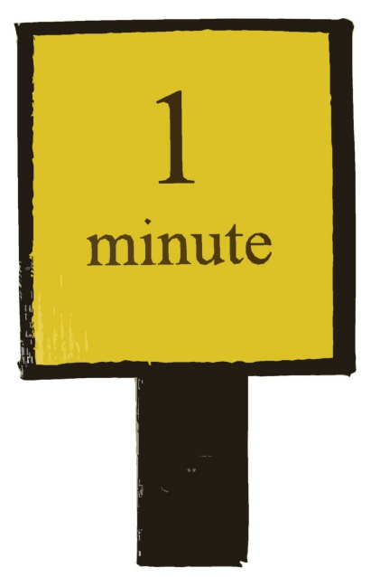
One Minute Preceptor – 5 “Ws”
What?
Get a commitment
Why?
Probe for supporting evidence
When. . .
Teach general rules/illness scripts
Woot!
Reinforce what was done right
Whoops/Womp
Give feedback/correct mistakes

Slide 9
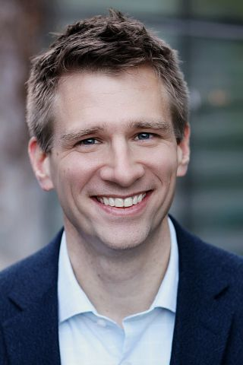
What was important to you in the history?
How did the PE change your differential diagnosis?
Matt Kelleher, MD, MEd

Slide 10
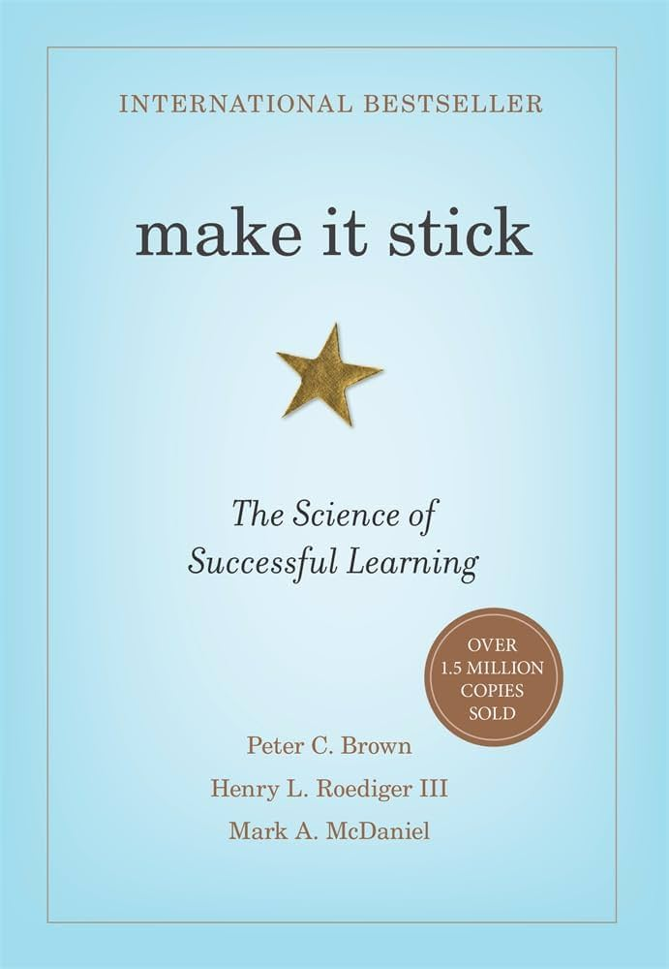

Slide 11
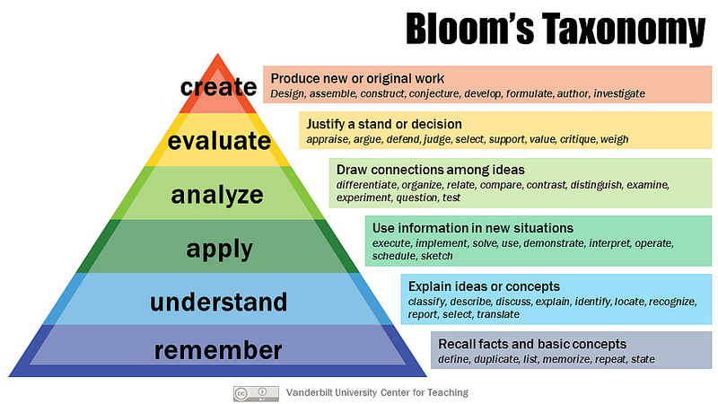
https://cft.vanderbilt.edu/guides-sub-pages/blooms-taxonomy/

Slide 12
Complexity vs Difficulty
Complexity – describes cognitive process, more complex = higher level in Bloom’s
Difficulty – amount of effort learners use within a level of complexity
Sousa, D. (2011). How the Brain Learns.
Notes:
how much thinking, problem-solving, reasoning, or creativity it requires.

Slide 13
Create
Understand
Remember
Evaluate
Analyze
Apply

Slide 14
Difficulty
Difficulty
Create
Evaluate
Analyze
Apply
Understand
Remember
Complexity
Difficulty
Difficulty
Difficulty
Difficulty
Notes:
Which do we usually increase when trying to help our learners retain?
Which one is linked with ability? Difficulty
Which one is linked with retention? Complexity

Slide 15
Difficulty vs complexity
Complexity
Higher complexity = deeper understanding and longer retention
Difficulty
Better for determining ability (summative), but why are you asking questions?
Sousa, D. (2011). How the Brain Learns.
Notes:
Learners of any ability level can have increased complexity

Slide 16
Complexity
What does this urinalysis tell you regarding the cause of this AKI?
Is FeNa a cost-effective test for evaluating AKI?
Difficulty
What are two causes of intrinsic acute kidney injury?
What is the equation for FeNa?
Create
Evaluate
Analyze
Apply
Understand
Remember
Notes:
Which do we usually increase when trying to help our learners retain?
Which one is linked with ability? Difficulty
Which one is linked with retention? Complexity

Slide 17
Complexity
Create the ideal strep test – what would that look like?
How does a negative rapid strep test affect your management?
Difficulty
How sensitive is this rapid strep test?
What is the negative likelihood ratio for this rapid strep test?
Create
Evaluate
Analyze
Apply
Understand
Remember
Notes:
Which do we usually increase when trying to help our learners retain?
Which one is linked with ability? Difficulty
Which one is linked with retention? Complexity
Liveborn
Septicemia, OA, CHF, PNA, Mood dsos, cardiac dysrhthmias, other complications of birth, device complication, AMI

Slide 18
Exercise
Bloom’s Level | Increasing difficulty
Create
Evaluate
Analyze
Apply
Understand
Remember

Slide 19
Bloom’s Level | Prompts
Create | Design, imagine
Evaluate | Give a judgment, make an assessment, critique
Analyze | Contrast and distinguish components
Apply | Calculate, determine, use the knowledge
Understand | Summarize, explain, discuss
Remember | List, define, recall, identify

Slide 20
Other Qs about Qs
Wait time?
At least 5 seconds
20 seconds-2 minutes
Higher the complexity, longer the wait time
Can be detrimental to NOT wait long enough
Walk up the hierarchy?
No consensus
In front of patients?
Maaaaaaaybe
Oyler, D. (2014). "The Fact of Ignorance: Revisiting the Socratic Method as a Tool for Teaching Critical Thinking."
American Journal of Pharmaceutical Education 78(7).
Tofade, T. (2013). "Best Practice Strategies for Effective Use of Questions as a Teaching Tool." American Journal of Pharmaceutical Education 77(7).
Oh, R. (2014). "The Socratic Method and Pimping: Optimizing the Use of Stress and Fear in Instruction." American Medical Association Journal of Ethics 16(3).
Sousa, D. (2011). How the Brain Learns.
Wiese, J. (2015). Teaching in the Hospital.

Slide 21

Asking Qs in front of patients
Prepare patients and learners
Save feedback for outside the room
“Yes, and”
Beware the downward spiral of confidence
Lehmann, L. (1997). N Engl J Med 336(16).
Abdool MA, Medical teacher. 2013;35(11):895-899.
Kogan JR, et al. Perspect Med Educ. 2017;6(5):286-305.

Slide 22
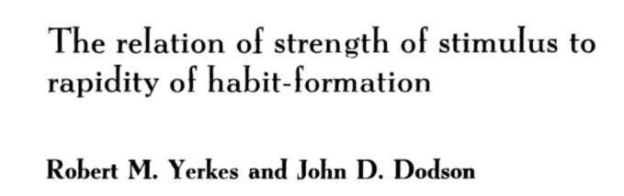
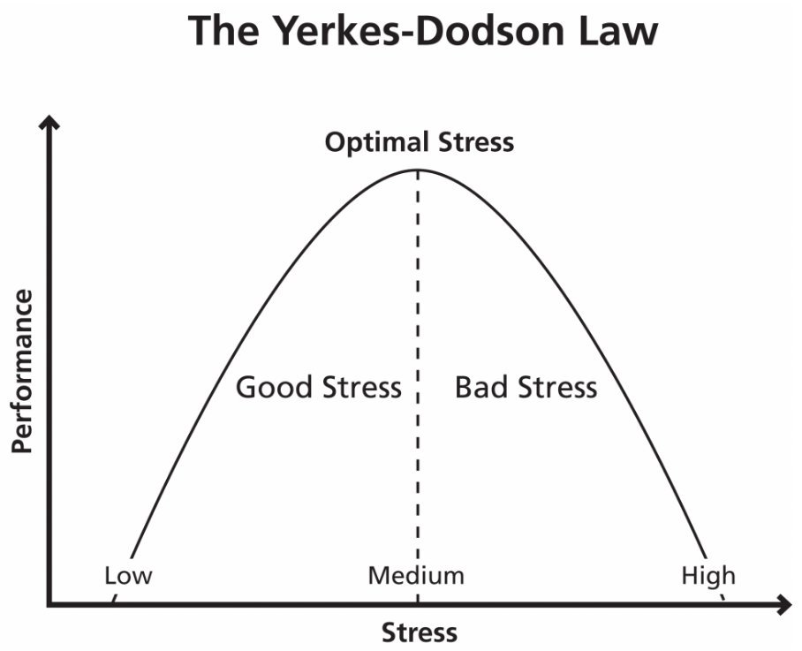
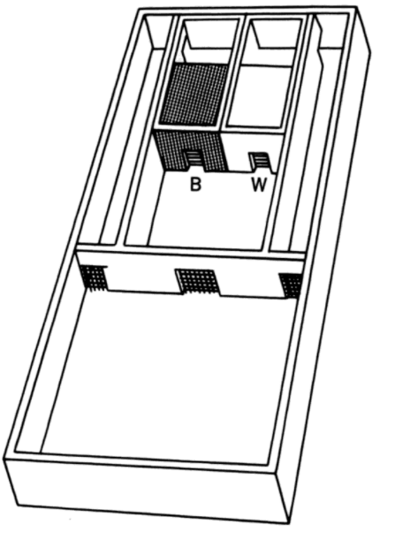
Does stress make info stick?
Notes:
1908
The habit whose formation we attempted to study quantitatively, with respect to the strength of the stimulus which favored its formation, may be described as the white-black discrimination habit. Of the mice which served as subjects in the investigation it was demanded that they choose and enter one of two boxes or passage-ways. One of the boxes was white; the other black. No matter what their relative positions, the subject was required to choose the white one. Attempts to enter the black box resulted in the receipt of a disagreeable electric shock. It was our task to discover (1) whether the strength of this electric stimulus influences the rapidity with which dancers acquire the habit of avoiding the black passage-way, and if so, (2) what particular strength of stimulus is most favorable to the acquisition of this habit.
Each of the forty mice experimented with was given ten tests every morning until it succeeded in choosing the white box correctly on three consecutive days, that is for thirty tests. A choice was recorded as wrong if the mouse started to enter the black box and received a shock; as right if, either directly or after running from one entrance to the other a number of times, it entered the white box.
All of the subjects acquired a habit quickly. Comparison of these results with those obtained with the weak stimulus clearly indicates that the medium stimulus was much more favorable to the acquirement of the white-black visual discrimination habit.
In its results the strong stimulus proved to be similar to the weak stimulus. All of the mice in this case learned more slowly [p. 471] than did those which were trained with the medium strength of stimulus.
The general result of this preliminary set of experiments with three roughly measured strengths of stimulation was to indicate that neither a weak nor a strong electrical stimulus is as favorable to the acquisition of the white-black habit as is a medium stimulus.

Slide 23
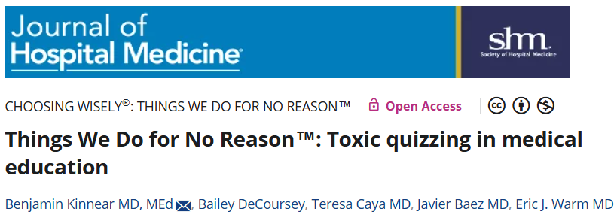
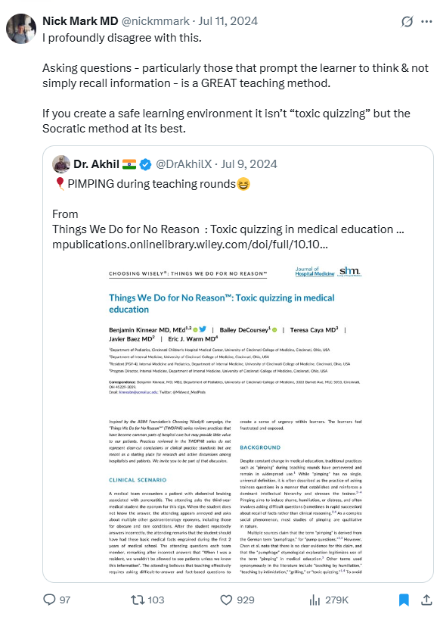
“Educators can effectively push learners to the limits of their abilities, and hence cause stress. However, it must be done in a supportive learning environment that fosters a growth mindset, which is antithetical to intimidation and hierarchy‐reinforcing techniques.”

Slide 24
The Art of Pimping
Brancati – JAMA, 1989
“Proper pimping inculcates the intern with a profound and abiding respect for his attending physician while ridding the intern of needless self-esteem. Furthermore, after being pimped, he is drained of the desire to ask new questions that his attending may be unable to answer”
Brancati (1989).

Slide 25
The Art of Pimping
“Pimping questions should come in rapid succession and should be essentially unanswerable”
Arcane points of history
Teleology and metaphysics
Exceedingly broad questions
Eponyms
Technical points of laboratory research
Brancati (1989).

Slide 26
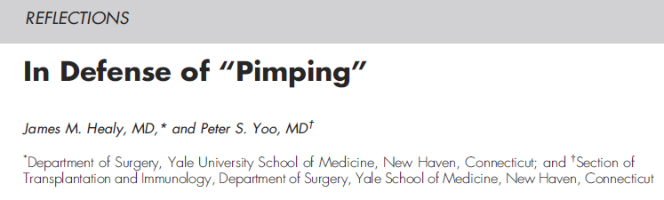
Healy JM, Yoo PS. Journal of surgical education. 2015.

Slide 27
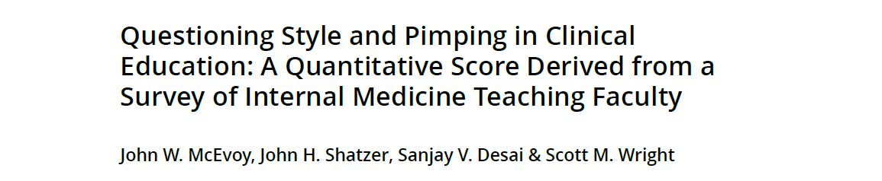

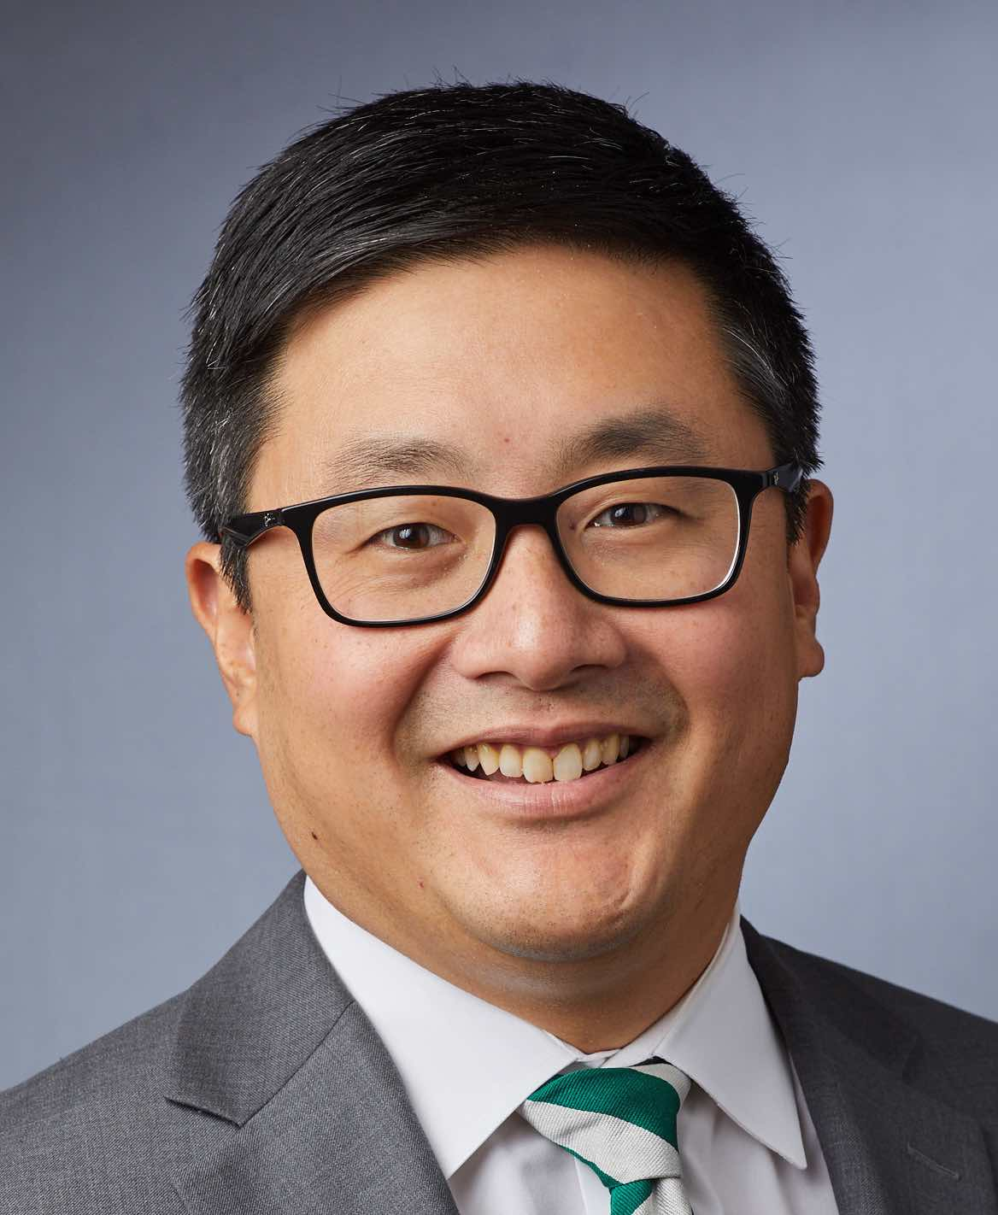
High “pimping scores” were more likely to be:
Male
Younger
Specialists
Reporting lower quality of life
Notes:
Study of 150 IM faculty at Johns Hopkins with recent inpatient teaching. 13 question score – largely avoided the word “pimping”. Questions generated, piloted, revised with multiple education faculty.

Slide 28
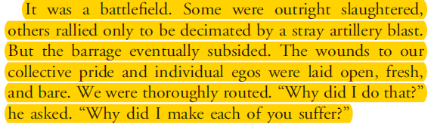
Healy JM, Yoo PS. Journal of surgical education. 2015.

Slide 29
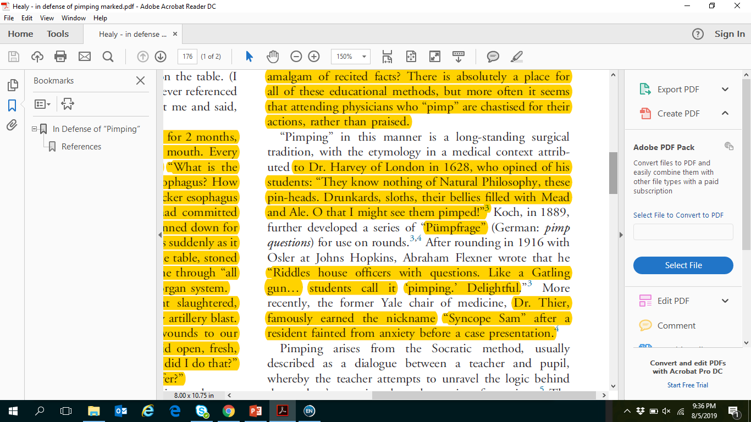
Healy JM, Yoo PS. Journal of surgical education. 2015.

Slide 30
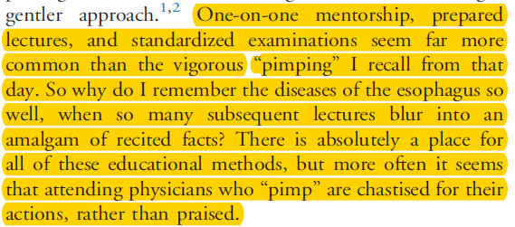
Healy JM, Yoo PS. Journal of surgical education. 2015.

Slide 31
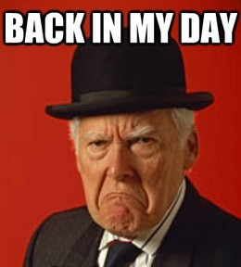
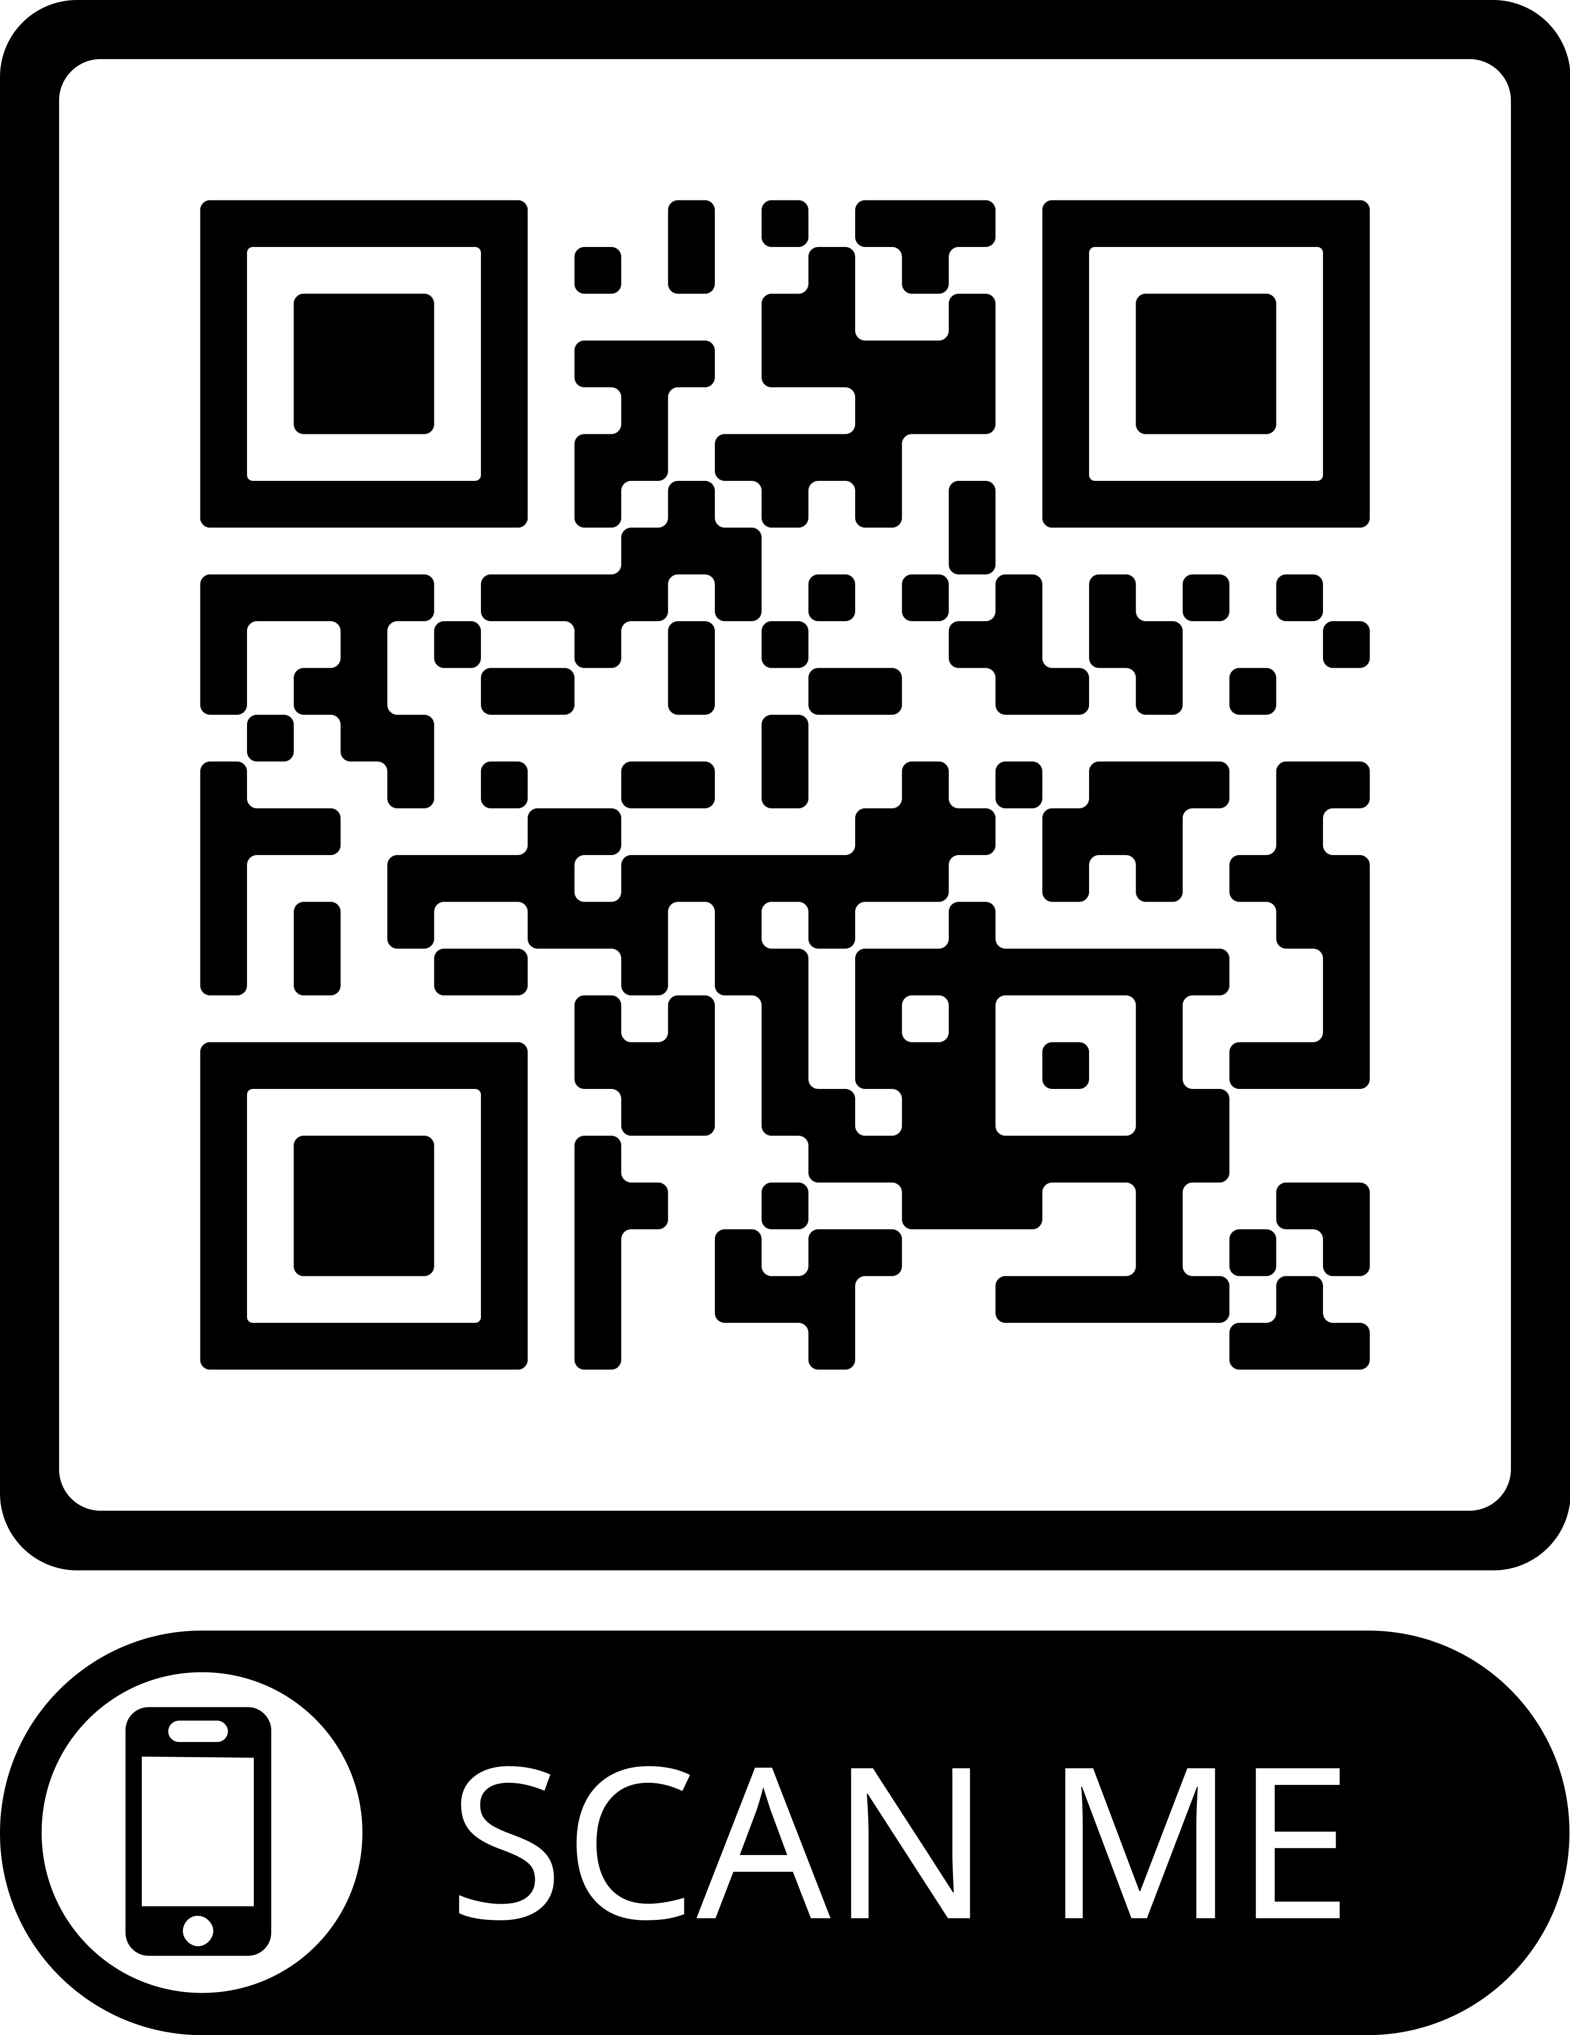
“Nostalgialitis imperfecta profunda”

Slide 32
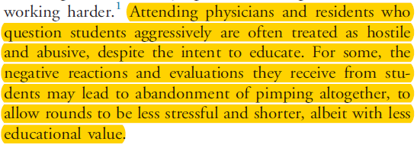
Healy JM, Yoo PS. Journal of surgical education. 2015.

Slide 33
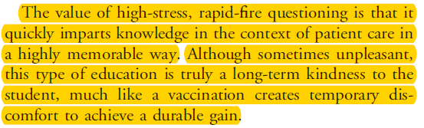
Healy JM, Yoo PS. Journal of surgical education. 2015.

Slide 34
Healy’s argument
Pimping may cause learners discomfort, BUT
It leads to better learning, AND
The harm is not severe, THEREFORE
The benefit outweighs the risk

Slide 35
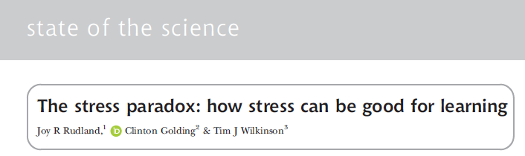
Stressor – force that is applied (challenge or learning situation)
Stress – learner realization of a stressor
Outcome – affective disposition + learning
Distress
Negative affect due to stress
Eustress
Positive affect due to stress
Rudland, J. R., Golding, C., & Wilkinson, T. J. (2019). The stress paradox: how stress can be good for learning. Medical education

Slide 36
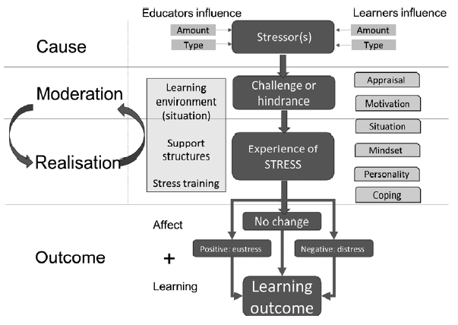
Stress impacts learning
Rudland, J. R., Golding, C., & Wilkinson, T. J. (2019). The stress paradox: how stress can be good for learning. Medical education

Slide 37
Teaching in the room
Data affecting survival
Working memory
Data generating emotions
Data for new learning
Sousa, D. (2011). How the Brain Learns.

Slide 38
“Findings: Negative emotions including anxiety and self-doubt dominated among the learners during pimping encounters. For some, these resulted in motivation to study, and for others this was a futile, nonmotivating experience.”
“Most trainees felt that they were being judged during pimping; however, they perceived that the intentions of pimping were not malicious and in their best interests.”
Goebel EA, Cristancho SM, Driman DK. Pimping in Residency: The Emotional Roller-Coaster of a Pedagogical Method - A Qualitative Study Using Interviews and Rich Picture Drawings. Teach Learn Med. 2019:1-9.

Slide 39
Healy’s argument
Pimping may cause learners discomfort, BUT
It leads to better learning, AND
The harm is not severe, THEREFORE
The benefit outweighs the risk

Slide 40
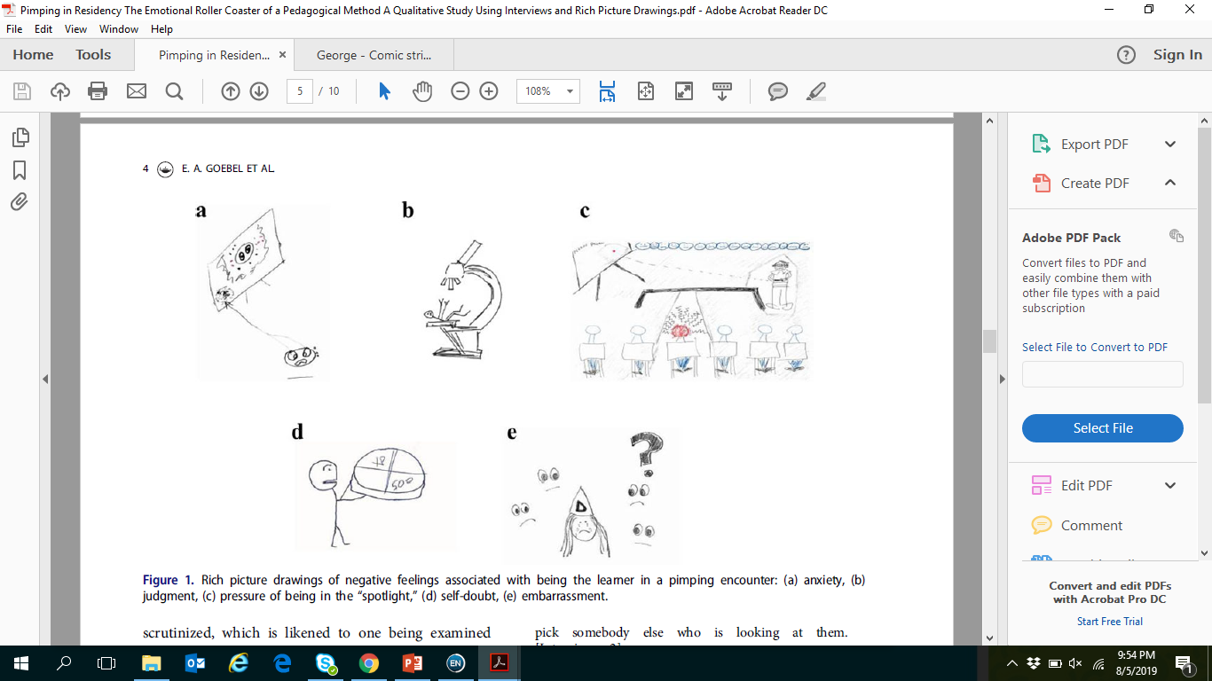
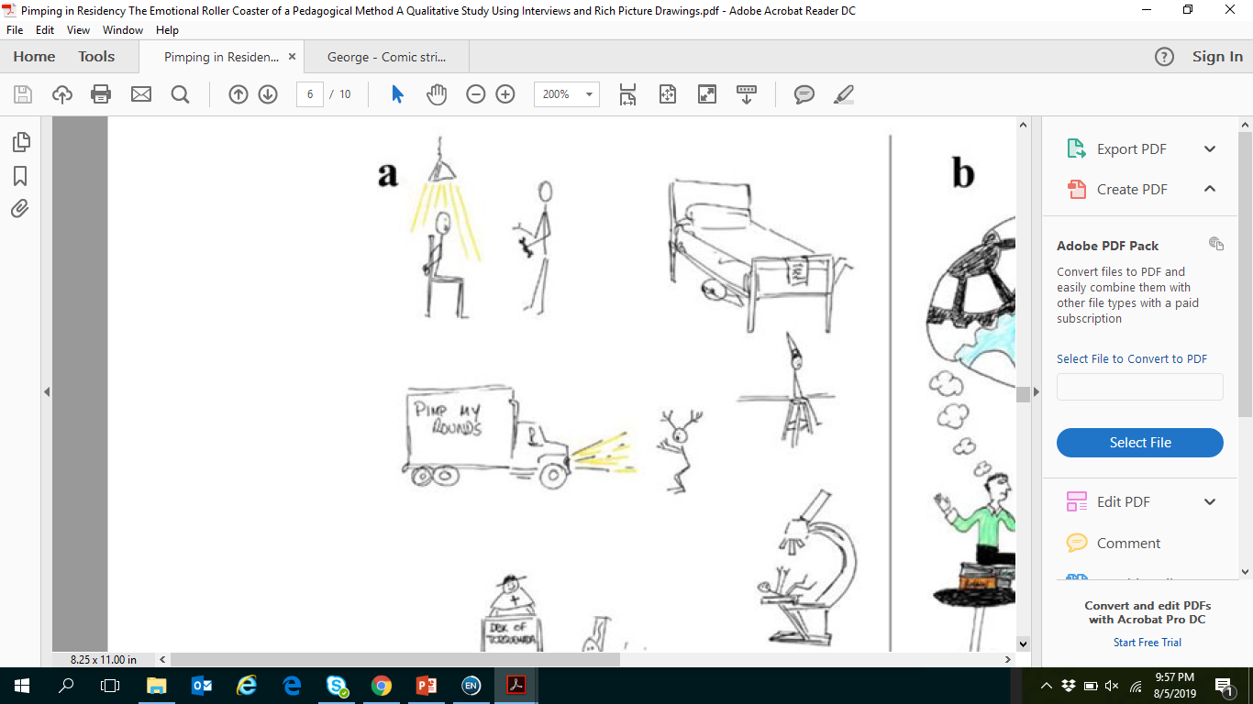
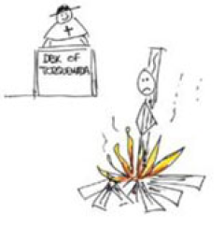
George DR JAMA. 2015;314(22):2345-2346.
Goebel EA, Teach Learn Med. 2019:1-9..

Slide 41
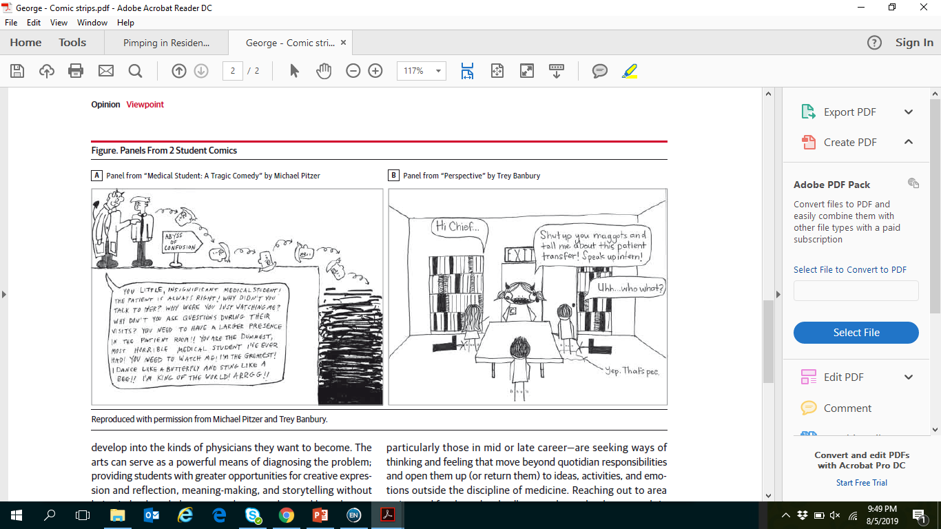
George DR Jama. 2015;314(22):2345-2346.
Goebel EA, Teach Learn Med. 2019:1-9..

Slide 42
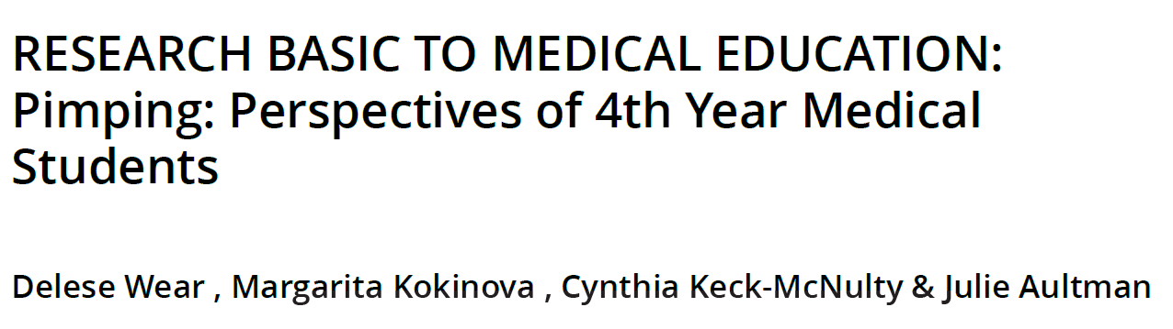
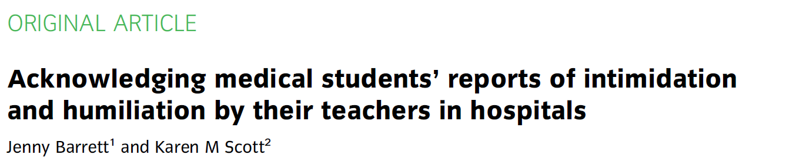



Slide 43
Healy’s argument
Pimping may cause learners discomfort, BUT
It leads to better learning, AND
The harm is not severe, THEREFORE
The benefit outweighs the risk

Slide 44

Creating safety
Set ground rules
Questions are NOT for summative purposes
2-way street
Ask for feedback from learners
Say “I don’t know”
Follow up
Don’t beat a dead horse
Avoid ambiguity
Oyler, D. (2014). American Journal of Pharmaceutical Education 78(7)
Tofade, T. (2013). American Journal of Pharmaceutical Education 77(7).
Oh, R. (2014). American Medical Association Journal of Ethics 16(3).

Slide 45
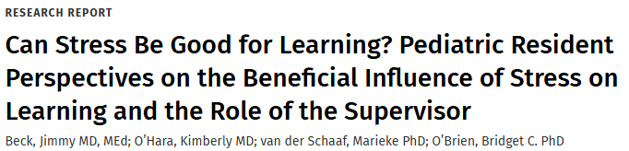
Generative stress
Provide autonomy
Hold learners accountable
Set high expectations
Normalize stress and check-in about it

Slide 46
What if you’re being pimped?
Avoidance
The Muffin
The Hostile Response
The List
Pimp Back
“Eclipse”
“Camouflage”
“Meditation”
The Politician
Detsky, A. (2009). "The Art of Pimping." JAMA 301(13).

Slide 47
What your attending is showing this behavior?
Give the person feedback (verbal or written)
Let an education leader (e.g. chief, PD, etc) know so we can coach them
Model better approaches for your junior learners
If egregious, protect/support your junior learners and get help (see #2)

Slide 48
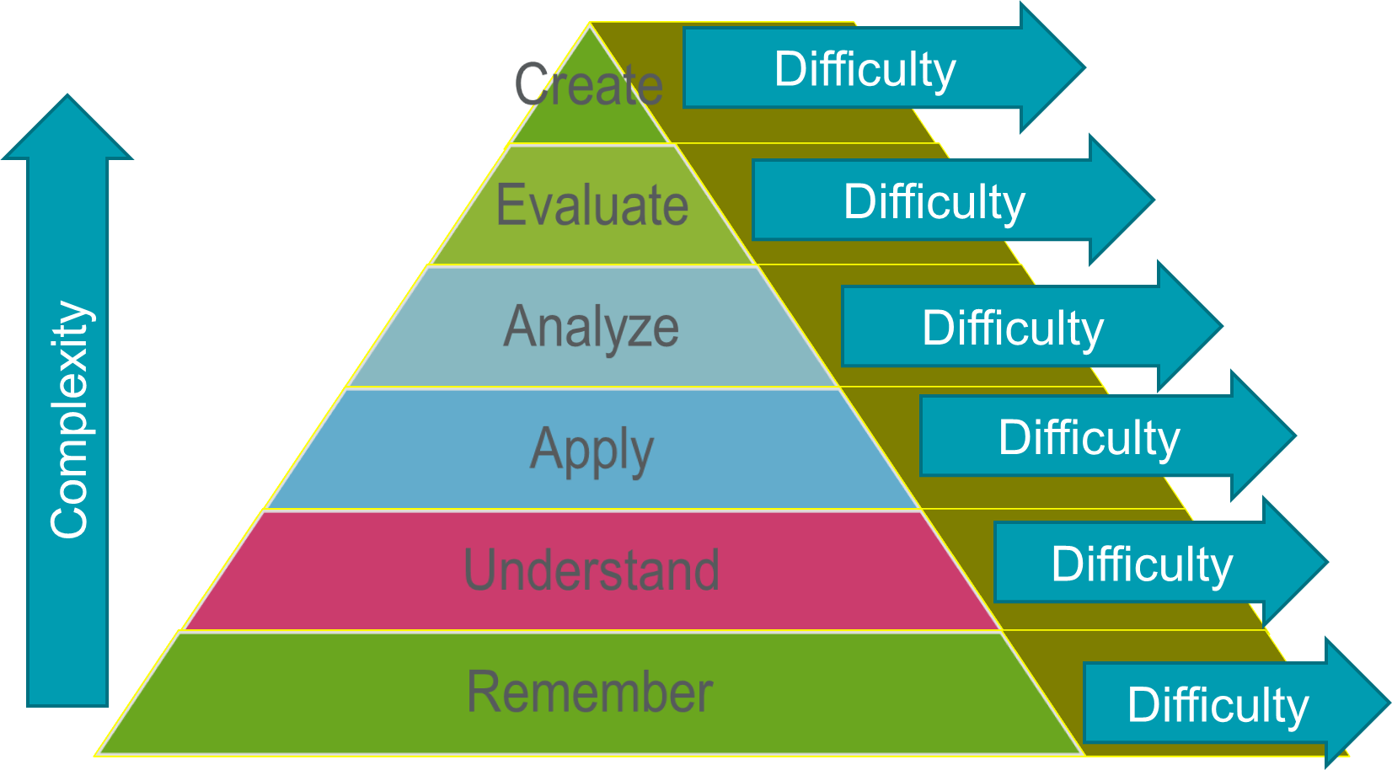

Slide 49
Learning objective
Develop an approach to purposeful questioning WITH learners

Slide 50

How to Claim Your CE Credit
1
Visit http://utcop.learningexpressCE.com and create an account or log in. If it’s your first time to our site, you’ll need to create an account. Make sure to have your NABP ePID and DOB handy!
2
When you are logged in, click on the “My Account” tab and navigate to Pending/Private Activities.
Scroll to the bottom of Pending/Private Activities and type in the access code provided to you at your session.
3
Select Register Now once you have arrived at your program's page. After registering you will then complete the evaluation for this activity.
4
Questions?
Contact our office using the “Contact Us” form on our website or give us a call at 865-974-6605. Please note that,
consistent with A CPE’s policy, University of Tennessee College of Pharmacy is unable to award or correct credit for any reason, if more than 60 days have passed from the date of the activity.
After you complete your evaluation, attendance will be cross-checked against log-in records. A report will then be sent to CPE Monitor, using the NABP ePID and DOB you have stored in your profile. (see step 1)
5
Allow up to 48 hours to see your CE credit online in your NABP Profile.

Slide 51


CPE Credit
Your private event code for this program is: HSES25073
*This will be the code you enter at the bottom of the Pending/Private Events page.

