Slide 1
Balancing Compassion and Competence: Ethical Dilemmas in Assessing Struggling Learners
Ashley Hendrix, MD and Lauren King, MD
October 24, 2025

Slide 2
Objectives
Identify ethical tensions that arise when assessing struggling learners in healthcare education.
Explain the impact of personal values, institutional culture, and professional responsibilities on decision-making in learner assessment.
Identify strategies to approach learner assessment that balance empathy with accountability, grounded in ethical principles, and educational best practices.

Slide 3
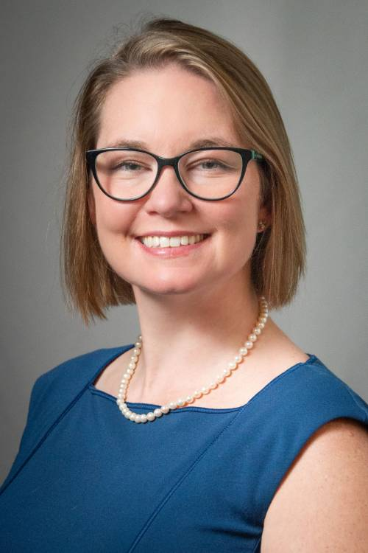

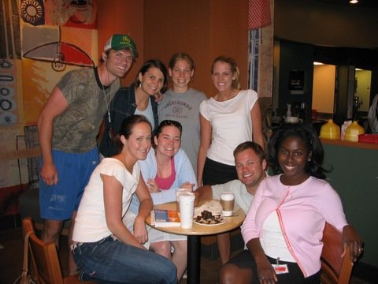
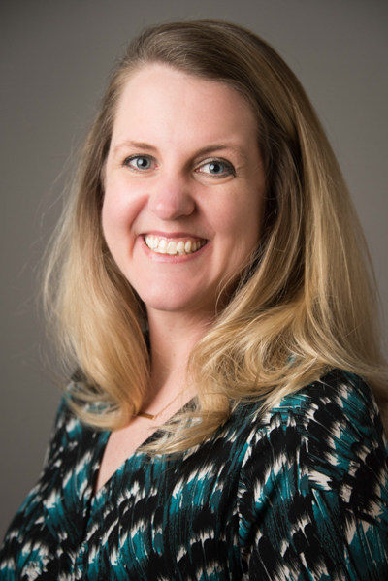
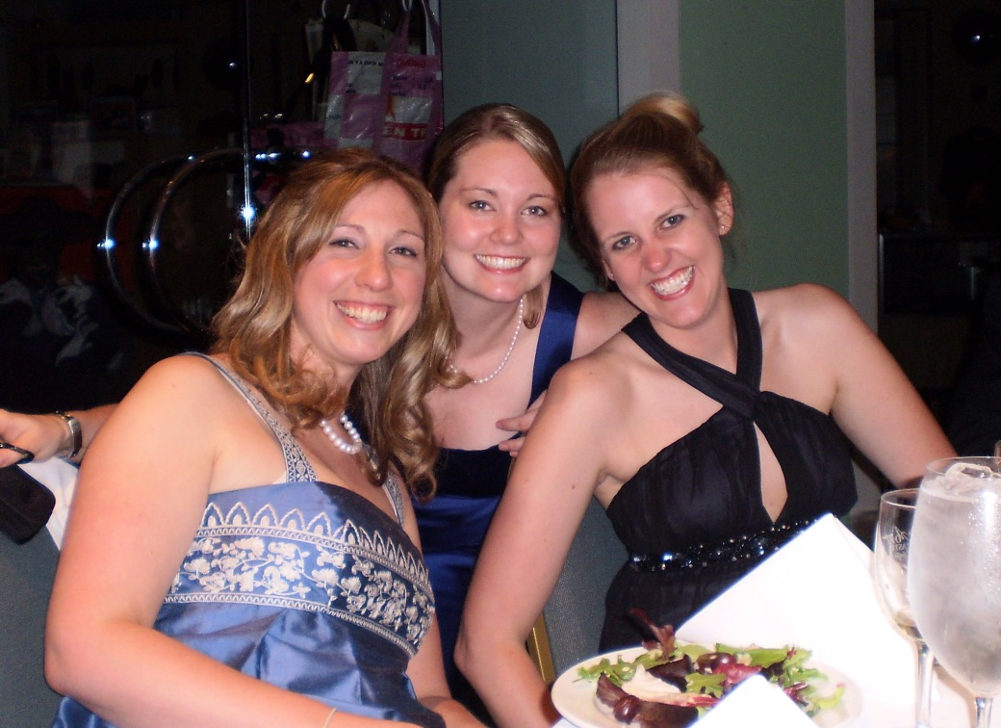
Then to Now
2005-2009
Present
Notes:
We were all learners at some point. We all felt ways about how we were assessed. We all are here to ensure fully capable people. We begin from where we came from.

Slide 4
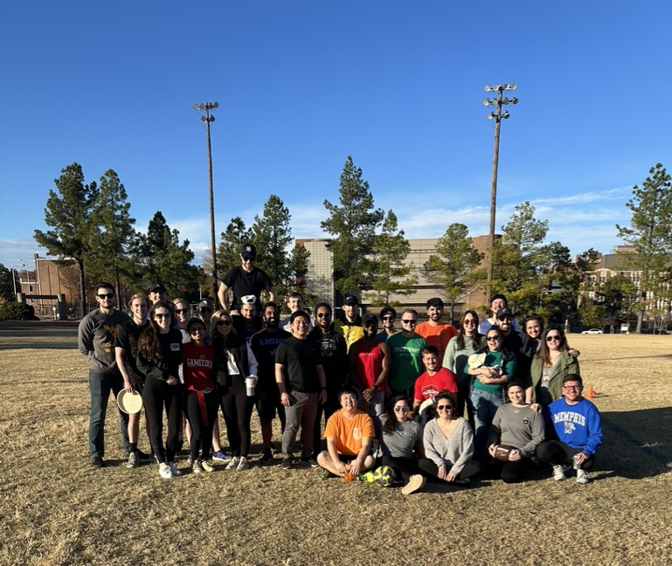

Our Why
The future.
Left: Pathology Residents Above: Surgery residents
Notes:
The why –
For the good of mankind - creating a set of fully functional excellent medical providers that I am proud to have helped
Selfishly – so there are people to take care of me that I can trust.

Slide 5
Reflection
Think of a time you struggled with an assessment decision – what made it difficult?

Slide 6
“Reading Emotion in a Statement where there was none”
Notes:
Medical educators are often torn between empathy for struggling learners and their responsibility to ensure competent, safe future physicians. We give feedback and worry about tone, delivery, and someone accepting the feedback and not being mad.
This session explores the ethical tensions that arise when assessors must balance compassion with the obligation to make honest, high-stakes decisions — particularly around remediation and failure.

Slide 7
Guiding Principles: Duality
Advocate
Gatekeeper

Slide 8
Guiding Principles: Ethical Principles
Educational:
  Transparency: expectations, evaluation
  Proportional responses (remediation vs. failure)
Institutional or External considerations:
  Influence of institution culture
  Systemic factors like workload, inadequate support, unclear expectations
Beneficence:
  Which actions will best support the learner’s growth and well-being?
Nonmaleficence:
  Could my decision cause harm to patients, peers, or the learner?
Justice:
  Am I being fair and consistent across learners?
Fidelity:
  Am I being transparent?
Integrity:
  Am I treating the learner with dignity and respecting their agency?

Slide 9
Break up into small groups
Notes:
We have created a set of Anonymized, realistic case vignettes of struggling learners
Lets break into small groups to choose a few that seem applicable to them.
For each vignette
What are the key ethical issues?
Would you pass or fail this learner? Why?
What support and feedback should be provided?
What institutional/systemic factors influence your decision?

Slide 10
Case 1

Slide 11
Alex – the early learner
Early pre-clinical learner on a rotation (example – M3 on first clinical rotation, or a P3 in an early clinical site rotation)
Alex is well-liked and seems highly motivated. Alex recently disclosed some personal challenges they are facing with finances, including needing to find a new pet-friendly affordable apartment. Supervisor feedback notes that Alex has great patient rapport, but seems to struggle in clinical reasoning, having difficulty generating any independent differential diagnoses or summarizing findings, but your team always steps in and helps because everyone loves Alex!
The supervisors that have worked with Alex have tried to coach and have given regular feedback, but there has been little improvement.
Do you pass Alex?
What supports, feedback, or remediation would be appropriate?
What are the risks of either decision (for Alex, the team, and patients)?
What institutional / systemic factors influence your decision (e.g. culture, policies, litigation, bias…)
Notes:
Learner has outside forces causing blurred lines – distracted? or really not competent?

Slide 12
Case 2

Slide 13
Aisha – the upper-level student on the wards
Aisha is a clinical student rotating with you on a “core” rotation (i.e. clerkship, or similar). She has previously struggled on pre-clinical examinations and end-of-rotation tests, but she has been working with a learning specialist and is always seen reading, studying, and if the first to arrive/last to leave every day. Her current preceptor finds that she struggles with recalling knowledge and performing tasks, including physical examination steps, that she should be able to perform. But – the preceptor notes that she is the “hardest working student she’s ever seen,” and is reluctant to fail someone who is trying so hard.
Do you pass Aisha?
What supports, feedback, or remediation would be appropriate?
What are the risks of either decision (for Aisha, the team, and patients)?
What institutional / systemic factors influence your decision (e.g. culture, policies, litigation, bias…)
Notes:
Ethical values in conflict
Desire to reward insight and effort vs. obligation to certify readiness for clinical practice

Slide 14
Case 3

Slide 15
Jordan – the gunner
Jordan is the top-of-the-class academically. While on your rotation, his performance of clinical skills and knowledge base are both very strong, but you have received multiple comments about a dismissive attitude toward laboratory staff, nurses, and respiratory therapists. You have also noted that he can be abrupt with other learners on the rotation. When these things are discussed with him, he states that “efficiency sometimes is perceived as being rude,” and feels that others are being “too sensitive.” You are responsible for assigning a final grade and comments on the rotation.
Do you pass Jordan?
What supports, feedback, or remediation would be appropriate?
What are the risks of either decision (for Jordan, the team, and patients)?
What institutional / systemic factors influence your decision (e.g. culture, policies, litigation, bias…)
Notes:
What ethical principles are at play / what values are in conflict?
Weighing cognitive excellence against professionalism and team-based care expectations.
What domessage es your decision send to others?
Synthesis: Ethical Frameworks / Principles
- Dual roles – instructor is an advocate AND a gatekeeper

Slide 16
Case 4

Slide 17
Dr. Caremore – the surgeon
Dr. Caremore is a senior surgical resident who frequently takes on complex cases or portions of cases independently, beyond their “credentialed” or entrusted responsibilities. When things go well, faculty members have praised Dr. Caremore for their great initiative and instinct, but there have been a few complications. After the complications, Dr. Caremore blames the “learning curve.” Feedback is mixed: from “future star!” to “unsafe and arrogant.” You are responsible for summative evaluation on this rotation.
Do you pass Dr. Caremore?
What supports, feedback, or remediation would be appropriate?
What institutional / systemic factors influence your decision (e.g. culture, policies, litigation, bias…)
Notes:
How do you maintain fairness if others are held to stricter standards?

Slide 18
Case 5

Slide 19
Lena -
Lena is a final-year pharmacy student on an inpatient rotation. She is personable, eager, and has been highly knowledgeable in teaching situations. But her preceptor notices that she has occasionally signed off on medication reconciliations without thorough verification. After the second time this happened, the preceptor spoke with her, and Lena noted that “she was trying to keep up,” and “didn’t want to look slow.” No patient harm occurred, but the behavior does violate policy of the institution.
Would you pass Lena?
Would you consider this a professionalism lapse or a learning error?
What supports, feedback, or remediation would be appropriate?
What institutional / systemic factors influence your decision (e.g. culture, policies, litigation, bias…)
Notes:
Tension - Compassion for a well-meaning but overextended learner vs. responsibility to enforce safe, accurate practice.

Slide 20
Case 6

Slide 21
Xander
Xander is a nursing student who has been performing satisfactorily on clinical rotation thus far. One day, a patient’s oxygen saturation begins dropping, and Xander’s preceptor asks him to help intervene. Xander freezes, and cannot seem to remember how to increase the flow of oxygen, nor how to position a non-rebreather mask. The preceptor quickly steps in and stabilizes the patient, but afterward Xander is quite shaken and upset. He shares with the preceptor that he “shut down under pressure.”
How much weight should this single event carry?
What supports, feedback, or remediation would be appropriate?
How do you differentiate between nervousness and lack of competence? Are there factors that would change how you differentiate?
What institutional / systemic factors influence your decision (e.g. culture, policies, litigation, bias…)
Notes:
Tension: Balancing empathy for an anxious learner vs. ensuring readiness to handle clinical crises.

Slide 22
Developing a Framework while Dealing with the Challenges

Slide 23

Framework:
1. Clarify the Dilemma
  Knowledge, skills?
  Professionalism? Safety?
  Insight? Clinical reasoning?

Slide 24
Framework:
2. Identify Stakeholders
Primary:
  Learner, patient, teaching team
Secondary?
  Institution, future patients, profession, accrediting bodies
Whose interests am I prioritizing – and why?

Slide 25
Framework:
3. Examine Underlying Values and Principles
Ethical Principle | Key Questions
Beneficence | What actions would best support the stakeholders?
Nonmaleficence | Could this decision harm stakeholders?
Justice | Am I being fair / consistent across learners?
Fidelity / Integrity | How can I be transparent and true to my role as assessor?
Respect for Persons | Am I giving the stakeholders (especially the learner) dignity and agency?

Slide 26
Framework:
3a. Reflect on Context/Culture and Potential Bias
How might my institutional culture be influencing this decision?
  Reluctance to fail? Hidden curriculum?
Are there implicit biases affecting my judgement?
  Personality, efforts, backgrounds?
Are there systemic issues contributing to the situation?
  Workload, unclear expectations, inadequate support?

Slide 27
Framework:
4. Generate Options -> Reach Decision
Potential options (may vary in different fields):
  No action
  Extension of learning experience
  Remediation
  Failure
Questions to consider with each option:
  Does this protect patient safety?
  Is this educationally fair and defensible?
  Is this compassionate but realistic?
Can be helpful to consider the questions for each option!

Slide 28

Framework:
5. Communication and Documentation
If needed – reach out to “experts” at institution
  Can help alleviate moral tension!
Communicate: honesty, respect
  Focus on behavior and performance, not personal worth
  Frame outcomes with standards that will be achieved and support that will be available
Documentation
Due process

Slide 29

Framework:
6. Reflect and Learn
What did I learn about my own values or biases?
How might my program / rotation / course improve to provide early support?
How can I sustain empathy while maintaining professional responsibility?

Slide 30
Summary: Potential Framework
Clarify the dilemma
Identify the stakeholders
Examine the underlying principles
  Reflect on context/culture - Potential Bias?
Generate options -> Reach Decision
Communicate and Document
Reflect and learn

Slide 31

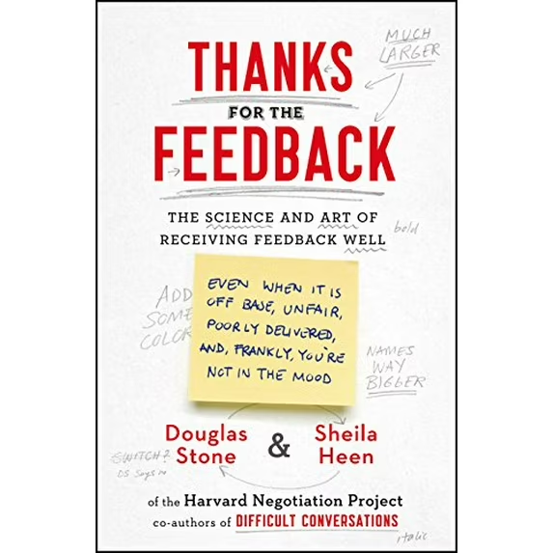

Tools and Closing Thoughts
Tools for feedback
Institutional considerations

Slide 32
I have not failed. I’ve just found 10,000 ways that won’t work.”
~ Thomas Edison
Notes:
FAILING WELL

Slide 34

How to Claim Your CE Credit
1
Visit http://utcop.learningexpressCE.com and create an account or log in. If it’s your first time to our site, you’ll need to create an account. Make sure to have your NABP ePID and DOB handy!
2
When you are logged in, click on the “My Account” tab and navigate to Pending/Private Activities.
Scroll to the bottom of Pending/Private Activities and type in the access code provided to you at your session.
3
Select Register Now once you have arrived at your program's page. After registering you will then complete the evaluation for this activity.
4
Questions?
Contact our office using the “Contact Us” form on our website or give us a call at 865-974-6605. Please note that,
consistent with A CPE’s policy, University of Tennessee College of Pharmacy is unable to award or correct credit for any reason, if more than 60 days have passed from the date of the activity.
After you complete your evaluation, attendance will be cross-checked against log-in records. A report will then be sent to CPE Monitor, using the NABP ePID and DOB you have stored in your profile. (see step 1)
5
Allow up to 48 hours to see your CE credit online in your NABP Profile.

Slide 35


CPE Credit
Your private event code for this program is: HSES25088
*This will be the code you enter at the bottom of the Pending/Private Events page.

