Slide 1
Direct Observation for CB(M)E
Bill Dabbs MD, Shaunta’ Chamberlin PharmD

Slide 2
Disclosures
We have no relevant financial or other disclosures

Slide 3
Session Objectives
Describe the benefits of direct observation in resident assessments.
Describe direct observation strategies in clinical settings and provide targeted, formative feedback using standardized tools.
Explain how direct observation into routine precepting workflows to enhance assessment accuracy and support resident development.
Identify and address clinical performance gaps early, leading to safer and more effective patient care.

Slide 4
Who’s in the room?
Implementers?
Dreamers?
Those without a clue?

Slide 5
Competency Based Education
ACGME, AAMC, AACN, and others are moving to CBE with new requirements and Core Outcomes
Stemming from worsening health outcomes in US
Centers the patients, community and practice
Aligns community needs with outcomes in training
Provides flexibility in progression and sequencing to meet learner needs, rather than forcing a fixed pathway
Emphasizes learning through experience and application, not just knowledge acquisition
Engages learners to build skills needed for practice

Slide 6
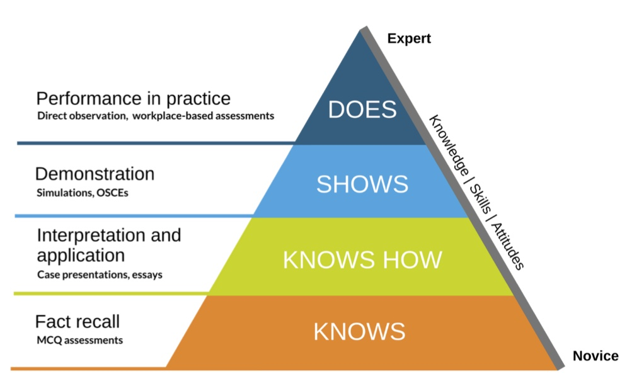
Miller's Assessment Pyramid
https://www.saskoer.ca/ideabook/chapter/millers-pyramid-of-clinical-competence/

Slide 7
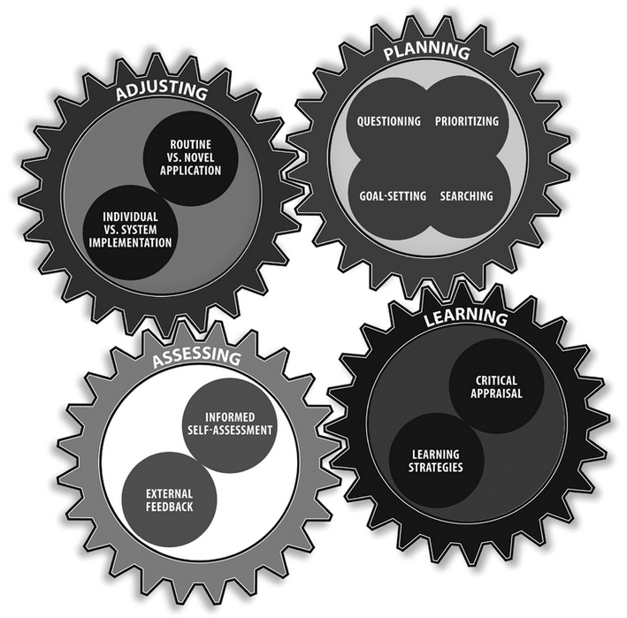
Master Adaptive Learner

Slide 8
Why Direct Observation?
Consistent with move towards competency based medical education
Supports learner development of as a master adaptive learn using individualized and targeted feedback, reflection, and coaching
Furthers goal of safe, effective, patient care
Removes bias from assessment
Improves assessment of core outcomes
Allows for earlier intervention and improvement
Notes:
Move away from time or numbers based and into skills and practice based determination of competency.

Slide 9
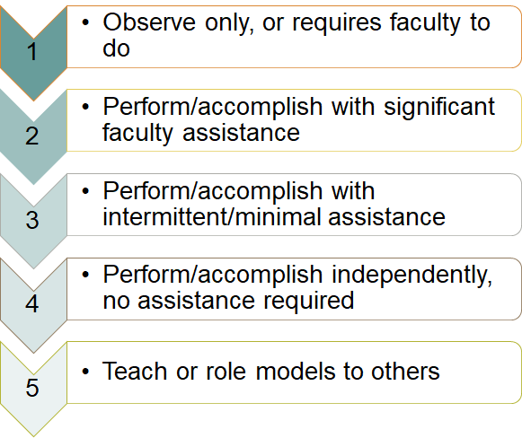
Utilizes Entrustability

Slide 10
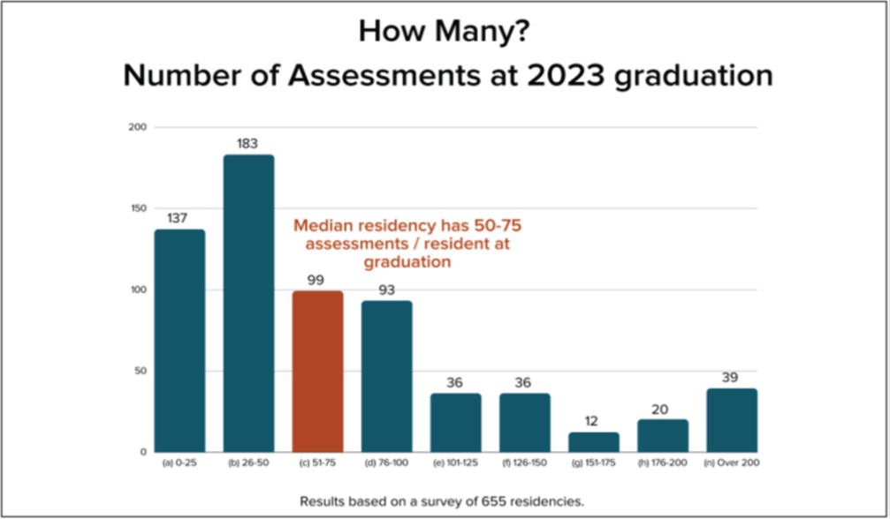
Canada does 1500!
https://stfm.org/teachingresources/resources/cbme-toolkit/cbme-faculty-development-webinars/#36830

Slide 11
Paradigm Shift
Current Standard | Direct Observation
Summative feedback | Formative feedback
High risk of bias | Reduced risk of bias
Focuses on knowledge acquisition | Focuses on knowledge application
Gestalt | Specific
Referenced to norm | Referenced to a standard/criterion
Difficult to track progression | Allows for progression monitoring

Slide 12
Standard Assessments and Bias
Assumptions made about the learner directly impact assessments
Heavily weighted by our own skills, which may not be expert in the area
Cognitive bias is rampant:
Horns and halos effect
Bandwagon effect
In group bias
Bias blind spots

Slide 13
Direct Observation vs Standard
Strategy | 1 | 2 | 3 | 4 | 5 | 6 | 7 | 8 | 9
Self | Not what I do |  |  | Close to what I do |  |  | Better than what I do
Gestalt | Worse than I expected |  |  | What I expected |  |  | Better than I expected
Criterion Based | Missing elements |  |  | Most elements |  |  | All elements

Slide 14
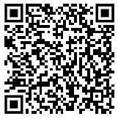
Let’s Jump In
Watch the next video and then complete the provided mini-CEX Rater Assessment Form in small groups
Pay closest attention to:
#5 Counseling Skills
Assigning a level of ongoing supervision
Observer
Direct Observation
Indirect Observation
No Supervision Needed

Slide 15
Formative Feedback
What did you observe the resident do well?
What, if any, errors or deficiencies did the resident commit?

Slide 16
Counseling Skills
Unsatisfactory 1 - 2 - 3
Satisfactory 4 – 5 – 6
Superior 7 - 8 - 9

Slide 17
Competency Ratings
Observer
Direct Supervision
Indirect Supervision
Unsupervised Practice
Notes:
Why are there variations in this room?

Slide 18
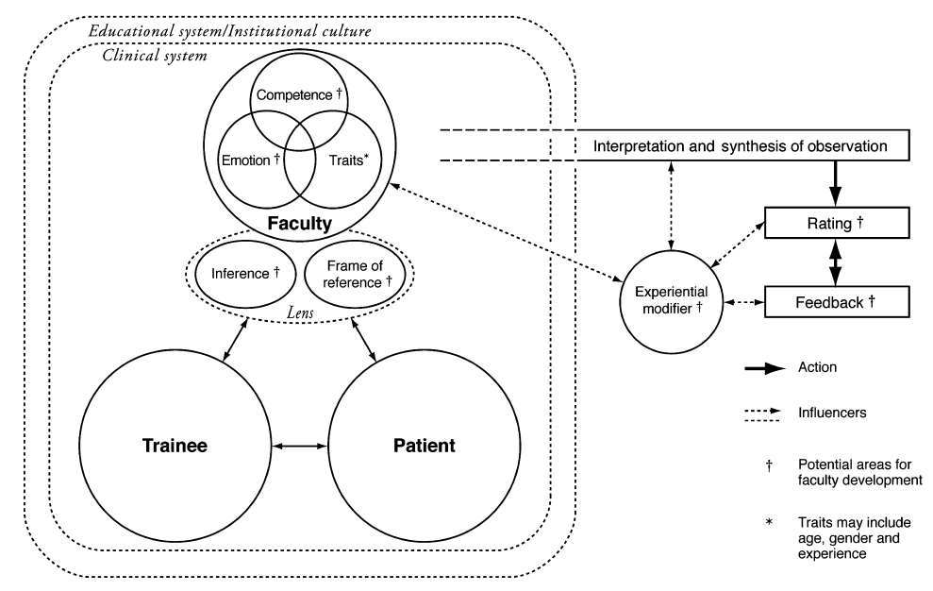
Kogan et al. Medical Education 2011: 45: 1048–1060. doi: 10.1111/j.1365-2923.2011.04025.x
Notes:
A note on rater variability

Slide 19
Expert Answer Key
https://acgme-my.sharepoint.com/:b:/g/personal/lconforti_acgme_org/EeWeEFqDDyxAj0N2uOiZYLsBf3MNzXddzQP_yKImldqhiQ?e=3p3aKD

Slide 20
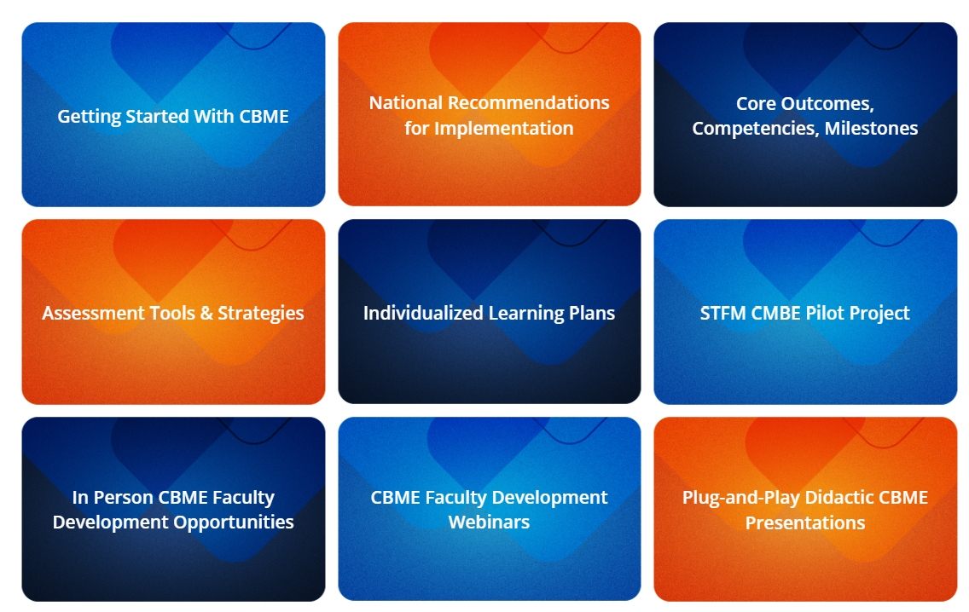
STFM CBME Toolkit
https://stfm.org/teachingresources/resources/cbme-toolkit/cbme-toolkit/

Slide 21
Snapshots
You don't have time to observe everything!
Get "snapshots"
Witness select portions of the teaching episode: HPI, PE, Plan, Informed Consent, procedure
Utilize standardized assessment form with entrustability scale
Encourage residents to select encounters for most applicable feedback

Slide 22
One to One Precepting
Assign a preceptor to a single resident and observe the day
Allows for highly individualized feedback
Opportunities for reflection, coaching and mentoring
Can witness many successes and opportunities for improvement in one day
Normalize feedback and growth mindset
Time intensive

Slide 23

Cameras
Cameras in room can allow for non-invasive witnessing of encounters
Consent patients to use of cameras during clinical encounters
Recordings may be helpful for resident viewing, but will need consent and proper storage for patient safety
Have a private viewing space for faculty
Can be known or unknown to resident when observation is occuring
Requires technology and IT support

Slide 24
No Camera! No Problem!
Be present in the room
Introduce yourself and your purpose
Hi! I'm Dr. X, one of the supervising doctors here. Today, I'll be observing Dr. Y during your visit as part of our teaching and training program—I'll be quietly watching so they can get feedback and continue developing their skills.
Avoid the temptation to talk or interrupt
Excuse yourself when you have completed your snapshot

Slide 25

Team Sport!
Get other health professions team members involved:
Medical assistants
Nursing
Pharmacy
Senior residents
Care coordinators
Social work
Behavioral health

Slide 26
Group Discussion
Break into small groups.
Discuss strategies that may work or have worked best to implement direct observation in your settings.
Share insights and ideas with your group members.

Slide 27
Barriers to Implementation
Engage: early and often
Communicate Clearly
Showcase Success
Participant Buy-In
Time
Competing Priorities
Change Management
Streamline the Process
Protect Time
Leverage Technology
Integrate into Existing Processes
Be Flexible
Top-Down Support
Resident & Faculty Development
Continual Process Improvement

Slide 28
Getting Buy In

Slide 29
Stakeholder Buy In
Learner, Faculty, and Administrative Buy-In is Crucial!
Invite stakeholders to engage in strategizing for implementation
Clearly communicate the vision and why this is important
Include how it benefits them!
Don't minimize the challenges
Provide avenue for feedback and process improvement

Slide 30
Learner Buy-In Game
Everyone take 1 index card
Write your idea on how to get residents excited and participating in direct observations
Partner with another person. Between the two of you, you have 5 points to award for the best idea.
We will swap partners 3 times and then identify the best ideas!

Slide 31
References
STFM CBME Toolkit for Residency Programs: https://stfm.org/teachingresources/resources/cbme-toolkit/cbme-toolkit/
Newton WP, Mitchell K. Reenvisioning Family Medicine Residency Education. Fam Med. 2021 Jul 7;53(7):487-489. doi: 10.22454/FamMed.2021.459102. Epub 2021 Jun 21. PMID: 34152595.
Humphrey-Murto S, Wood TJ, Ross S, Tavares W, Kvern B, Sidhu R, Sargeant J, Touchie C. Assessment Pearls for Competency-Based Medical Education. J Grad Med Educ. 2017 Dec;9(6):688-691. doi: 10.4300/JGME-D-17-00365.1. PMID: 29270255; PMCID: PMC5734320.
Newton W, Rode K. What Assessments Are Being Used in Family Medicine Residencies? The Journal of the American Board of Family Medicine. November 2023, jabfm.2023.230391R0; doi: https://doi.org/10.3122/jabfm.2023.230391R0
Newton W, Cagno CK, Hoekzema GS, Edje L. Core Outcomes of Residency Training 2022 (Provisional). Ann Fam Med. 2023 Mar-Apr;21(2):191-194. doi: 10.1370/afm.2977. Epub 2023 Mar 2. PMID: 36863777; PMCID: PMC10042560.
Holmboe ES, Sherbino J, Long DM, et al.. The role of assessment in competency-based medical education. Med Teach. 2010; 32 8: 676– 682.
Ross S, Poth CN, Donoff M, et al.. The competency-based achievement system: using formative feedback to teach and assess competencies with family medicine residents. Can Fam Physician. 2011; 57 9: e323– e330
Kogan, J.R., Conforti, L., Bernabeo, E., Iobst, W. and Holmboe, E. (2011), Opening the black box of clinical skills assessment via observation: a conceptual model. Medical Education, 45: 1048-1060. https://doi.org/10.1111/j.1365-2923.2011.04025.x
Cutrer WB, Miller B, Pusic MV, Mejicano G, Mangrulkar RS, Gruppen LD, Hawkins RE, Skochelak SE, Moore DE Jr. Fostering the Development of Master Adaptive Learners: A Conceptual Model to Guide Skill Acquisition in Medical Education. Acad Med. 2017 Jan;92(1):70-75. doi: 10.1097/ACM.0000000000001323. PMID: 27532867.
Tulshian P, Montgomery L, McCrory K, et al. National Recommendations for Implementation of Competency-Based Medical Education in Family Medicine. Fam Med. 2025;57(4):253-260. https://doi.org/10.22454/FamMed.2025.866091.

Slide 32
Questions?

Slide 33

How to Claim Your CE Credit
1
Visit http://utcop.learningexpressCE.com and create an account or log in. If it’s your first time to our site, you’ll need to create an account. Make sure to have your NABP ePID and DOB handy!
2
When you are logged in, click on the “My Account” tab and navigate to Pending/Private Activities.
Scroll to the bottom of Pending/Private Activities and type in the access code provided to you at your session.
3
Select Register Now once you have arrived at your program's page. After registering you will then complete the evaluation for this activity.
4
Questions?
Contact our office using the “Contact Us” form on our website or give us a call at 865-974-6605. Please note that,
consistent with A CPE’s policy, University of Tennessee College of Pharmacy is unable to award or correct credit for any reason, if more than 60 days have passed from the date of the activity.
After you complete your evaluation, attendance will be cross-checked against log-in records. A report will then be sent to CPE Monitor, using the NABP ePID and DOB you have stored in your profile. (see step 1)
5
Allow up to 48 hours to see your CE credit online in your NABP Profile.

Slide 34


CPE Credit
Your private event code for this program is: HSES25072
*This will be the code you enter at the bottom of the Pending/Private Events page.

