Slide 1
Professionalism in Progress: Assessing and Developing Professional Behavior in Health Professions Learners
Tom Laughner, PhD
Thomas Yohannan, MD
Amy McGregor, MD

Slide 2
Disclosures
Tom Laughner, PhD: None
Thomas Yohannan, MD: AAP Prep Editorial Board (Education CME) – author
Amy McGregor, MD: Royalties from Oxford University Press

Slide 3
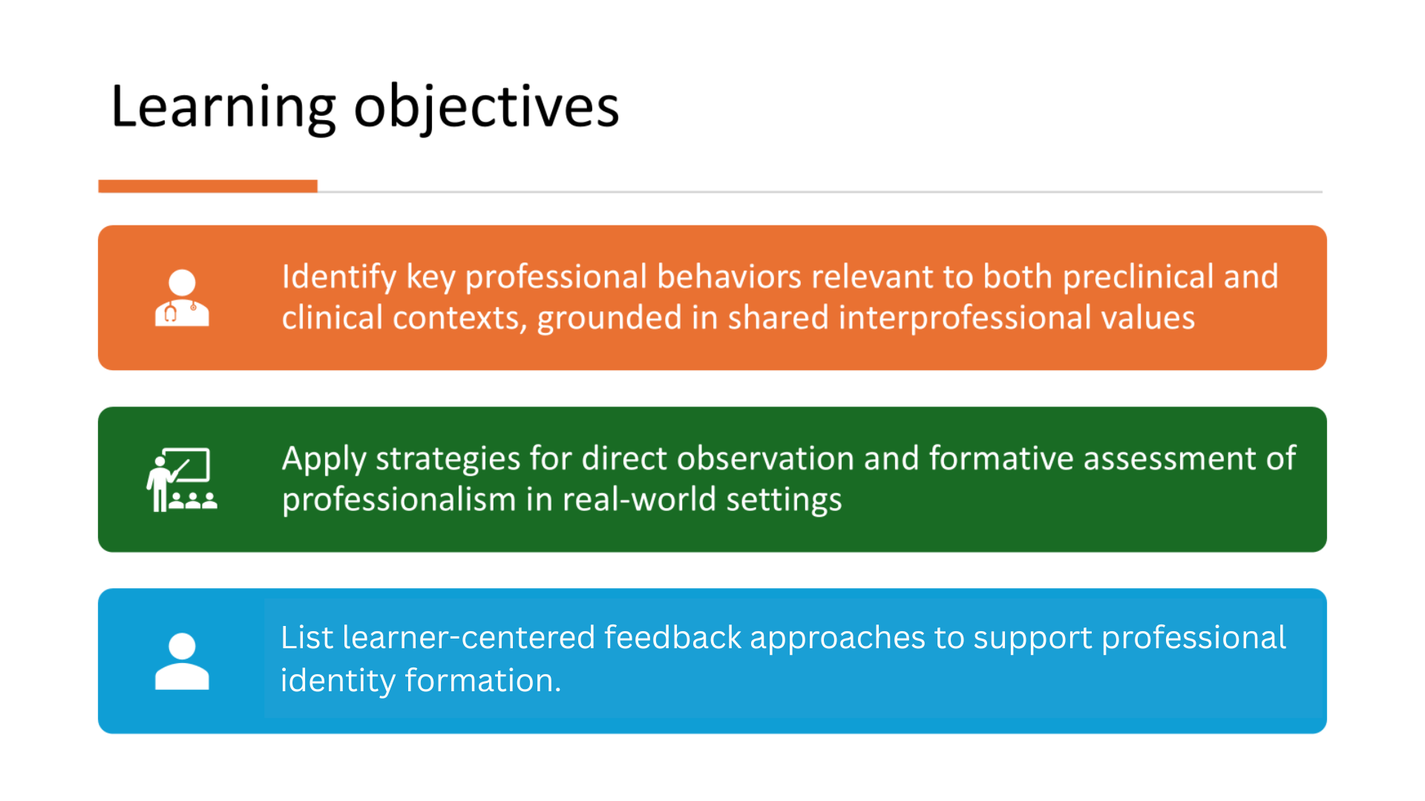

Slide 4
What is Professionalism?
How do you define it?

Slide 5
What is Professionalism?
There is no universally agreed definition of professionalism.
Tweedie J, Hordern J, Dacre J. Advancing medical professionalism. London: Royal College of Physicians, 2018

Slide 6
Professionalism in Healthcare
“Professionalism in healthcare settings is often referred to when discussing what is unacceptable or unprofessional.”
Collins K, Goodwin AM, Macpherson H et al. Top tips for promoting positive professionalism through medical education. MedEdPublish 2024, 14:66 (https://doi.org/10.12688/mep.20283.1)

Slide 7
Biases that Could Affect Perceptions of Professionalism
Confirmational bias
  Seeking out information that confirms our own assumptions or beliefs.
The halo effect
  A positive view of a person or one of their traits affects how their other characteristics/behaviors are viewed. (AM’s definition.)
The framing effect
  We may deduct different conclusions depending upon how that information is presented.
Inherent bias
  We draw conclusions based on our personal experiences.
(AM would add horn effect to this list.)
Collins K, Goodwin AM, Macpherson H et al. Top tips for promoting positive professionalism through medical education. MedEdPublish 2024, 14:66 (https://doi.org/10.12688/mep.20283.1)
Slide by A.M.

Slide 8
Potential Causes of Unprofessionalism “(7 D’s)”
Distraction: family concerns
Sleep Deprivation
Depression or other affective disorders
Drugs/alcohol
Disease (acute or chronic medical illness)
Learning Disability
Personality Disorder
https://www.ssmhealth.com/getmedia/0feeb1e6-832a-4095-a357-dd2432b358e4/remediation-toolkit.pdf which references the ACGME GME Resident Remediation Toolkit

Slide 9
Professionalism in Healthcare
“If we discuss professionalism through a positive lens, we are more likely to create a positive culture.”
Collins K, Goodwin AM, Macpherson H et al. Top tips for promoting positive professionalism through medical education. MedEdPublish 2024, 14:66 (https://doi.org/10.12688/mep.20283.1)

Slide 10
What is Professionalism?

Slide 11

https://quotefancy.com/quote/1622803/David-Halberstam-Being-a-professional-means-doing-your-job-on-the-days-you-don-t-want-to

Slide 12
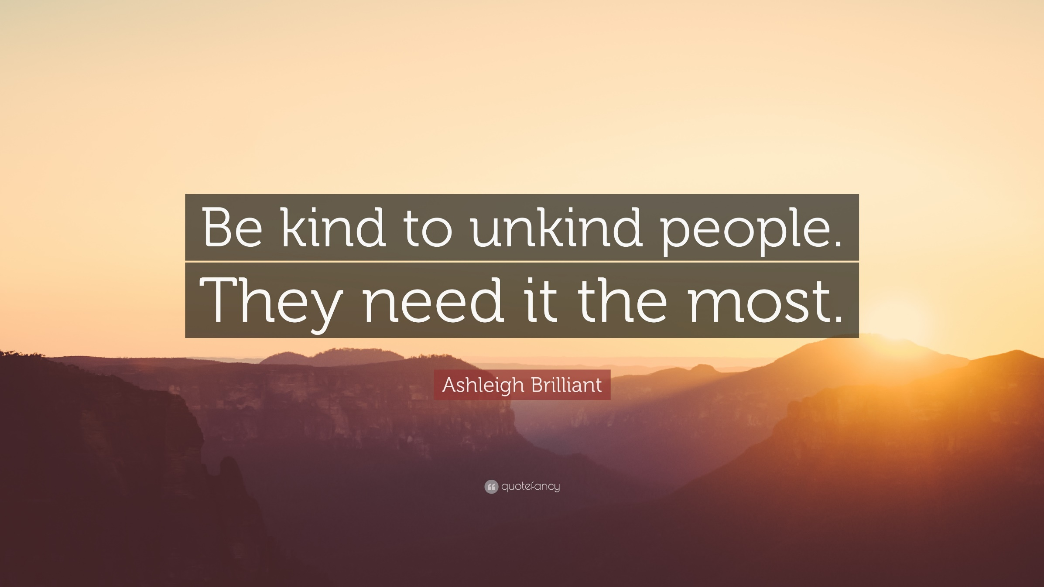

Slide 13


Slide 14

https://boksburgadvertiser.co.za/313709/metro-passes-ethics-exam/

Slide 15
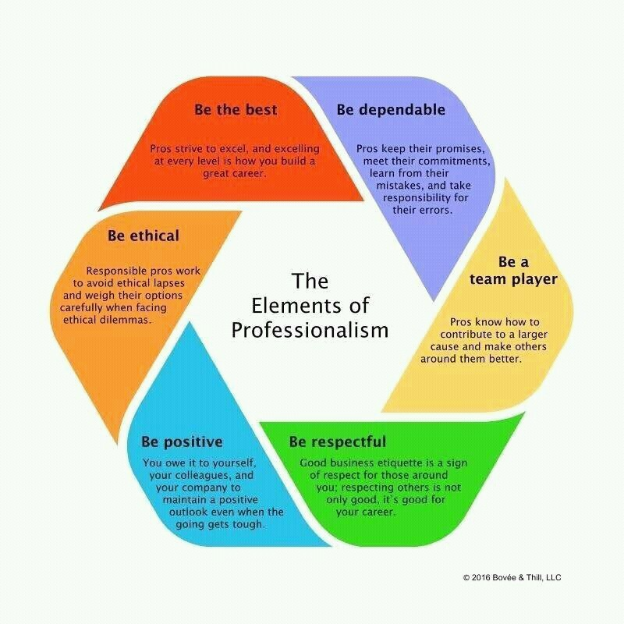
https://safety4sea.com/cm-the-6-elements-of-professionalism-in-seafaring/

Slide 16
Characteristics of Professionalism
Listening and reflecting on information | Maintaining a calm composure
Admitting limitations | Being ethical (respect autonomy, do no harm, be just, beneficence)
Treating everyone equally | Being organized
Communicating with patients, families, colleagues, and staff | Competence
Using correct names | Respect
Being persistent
http://www.uthsc.edu/tlc
Courtesy of Tom Laughner, PhD
Modified by AM for 2025

Slide 17
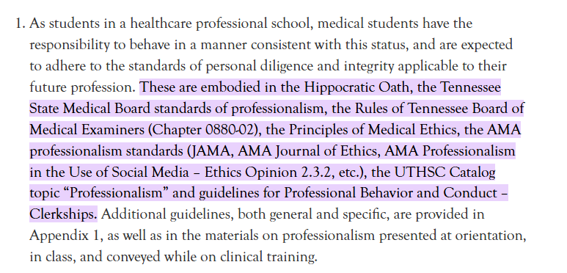
UTHSC’s Guidance Regarding Professionalism
COM121 Professionalism - COM Medical Education - UT System Policies
https://policy.tennessee.edu/procedure/com121-professionalism-com-medical-education/#:~:text=These%20are%20embodied%20in%20the%20Hippocratic%20Oath%2C%20the,guidelines%20for%20Professional%20Behavior%20and%20Conduct%20%E2%80%93%20Clerkships.

Slide 18
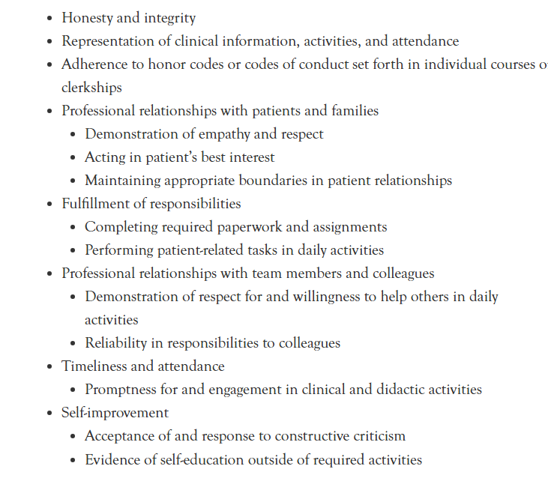
UTHSC Professionalism Expectations
COM121 Professionalism - COM Medical Education - UT System Policies

Slide 19
ACGME Core Competencies
Core Competencies: The six domains of educational and clinical knowledge, skills, and attitudes that physicians must develop for independent and autonomous practice of a specialty or subspecialty.
  Patient Care and Procedural Care
  Medical Knowledge
  Practice-based Learning and Improvement
  Interpersonal and Communication Skills
  Professionalism
  Systems-based Practice
ab_ACGMEGlossary.pdf

Slide 20
ACGME Requirements
Residents must demonstrate a commitment to professionalism and an adherence to ethical principles. Residents must demonstrate competence in:
  (a) compassion, integrity, and respect for others
  (b) responsiveness to patient needs that supersedes self-interest
  (c) respect for patient privacy and autonomy
  (d) accountability to patients, society, and the profession
  (e) respect and responsiveness to diverse patient populations, including but not limited to diversity in gender, age, culture, race, religion, disabilities, national origin, socioeconomic status, and sexual orientation
  (f) ability to recognize and develop a plan for one’s own personal and professional well-being
  (g) appropriately disclosing and addressing conflict or duality of interest.
ACGME 2020

Slide 21
Milestones

Slide 22

Being well is part of being a professional per the ACGME.
If you are exhausted and/or burned out, you are more prone to being unprofessional.
988 is a resource in the case of mental health emergencies.

Slide 23
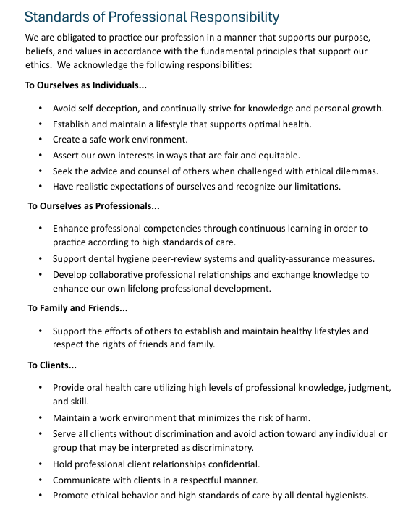
Excerpt from ADHA Code of Ethics. October 2024

Slide 24
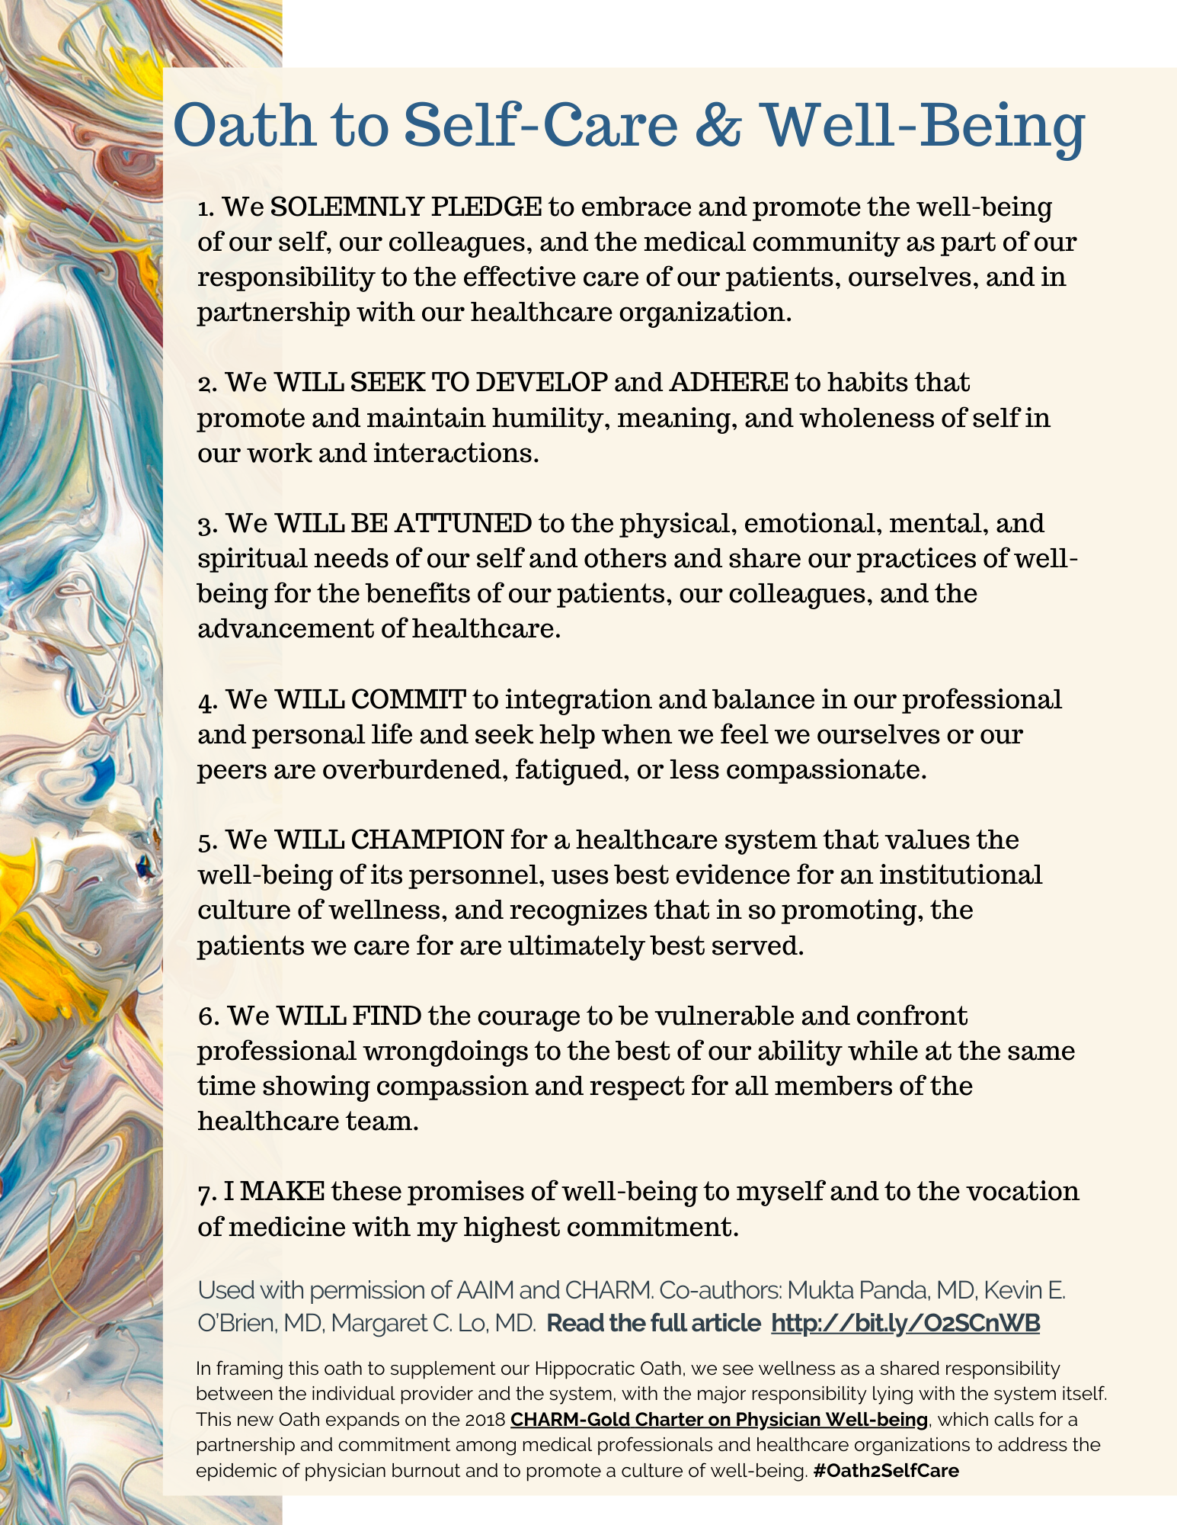
https://muktapandamd.com/oath-to-self-care-and-well-being/

Slide 25
Be well.

Slide 26
Teaching Professionalism
Four Strategies

Slide 27

Strategies to Teach Professionalism
vs
1. Case Studies

Slide 28
Case Study
A 6-month-old prematurely born infant you cared for in the NICU returns from surgery to the PICU. You learn that during surgery the endotracheal tube had been in the right main stem bronchus for several hours. You are no longer directly responsible for the infant, but the father continues to talk to you about his infant’s progress. The next three weeks are stormy. The infant contracts RSV, improves, and then dies suddenly. The autopsy is unrevealing. The father asks you if anything went wrong.
Points to consider during discussion: • Describe what you know about your institution’s policy for error disclosure to patients and families. • How does one balance responsibilities to patients/parents with colleagues/departments/ institutions? • If endotracheal tubes in the right main bronchus during surgery became a chronic occurrence in patients, what action would you take? • To whom would you raise your concerns? • What if you believe that the problem with the endotracheal tube and the nosocomial RSV infection had nothing to do with the infant’s ultimate death?
vs

Slide 29
How to develop CBL
Write Learning Objectives
Select Case
Develop Questions
Small Group Discussions
Debrief
Queen’s University Centre for Teaching and Learning. Case-Based Learning. https://www.queensu.ca/ctl/resources/instructors/instructional-strategies/case-based-learning
Notes:
What do you want students to learn from the discussion of the case?
What do they already know that applies to the case?
What are the issues that may be raised in discussion?
How will the case and discussion be introduced?
What preparation is expected of students? (Do they need to read the case ahead of time? Do research? Write anything?)
What directions do you need to provide students regarding what they are supposed to do and accomplish?
Do you need to divide students into groups or will they discuss as the whole class?
Are you going to use role-playing or facilitators or record keepers? If so, how?
What are the opening questions?
How much time is needed for students to discuss the case?
What concepts are to be applied/extracted during the discussion?
How will you evaluate students?
Develop Questions (open-ended) (groups must reach a decision, recommendation, prediction, judgment)

Slide 30
Resources
Copilot or UTVerse
TLC Resource Page

Slide 31
Strategies to Teach Professionalism
vs
2. Role Modeling
“Somebody’s watching you.”

Slide 32
Role Modeling
Be aware
Take time to teach
Be explicit
Facilitate reflection
Improve culture
Student-centered approach
Positive attitude
Demonstrate clinical competence
Talk with colleagues
vs

Slide 33
Role Modeling
Caring
Compassion
Insight
Openness
Respect
Presence
Competence
Commitment
Confidentiality
Autonomy
Altruism
Honesty
Ethical
Equity minded
Responsible to profession and society
Self regulation
Teamwork
Calm
Persistence
Communicate
Integrity
vs

Slide 34
Strategies to Teach Professionalism
vs
3. Reflection

Slide 35
Reflection
vs
The process of thinking critically and purposefully about one’s experiences, actions, and decisions to gain insight, deepen understanding, and improve future behavior.

Slide 36
Why Reflection
vs
Deeper learning
Meaning-making
Professional identity formation
Self-awareness
Adaptive behavior

Slide 37
Reflection
vs
What happened, and what did you notice about your own reactions?
What values or expectations were at play?
How might different team members have perceived this moment?

Slide 38
Strategies to Teach Professionalism
vs
4. Feedback

Slide 39
Feedback
vs
“Without feedback, mistakes go uncorrected, good performance is not reinforced, and clinical competence is achieved empirically if not at all.”
Ende J. (1983). Feedback in clinical medical education. JAMA, 250:6, 777-781.

Slide 40
Feedback
“Feedback is measured not at the speaker’s mouth, but at the listener’s ears. In other words, it’s not about what you say, but how the person hears and interprets it.”
vs
Rosoff, J., & Sandler, A. How to gauge feedback you’re giving and getting. Radical Candor Podcast S3, Ep. 4.

Slide 41
Feedback
“No matter how well intentioned or well crafted it is, feedback may be doomed to fail if it is not situated within a supportive learning culture.”
vs
Watling, C., Driessen, E., van der Vleuten, C.P.M., Lingard, L. (2014). Learning culture and feedback: An international study of medical athletes and musicians. Medical Education, 48(7), 713-723.

Slide 42
Professionalism in Practice

Slide 43
Case Studies

Slide 44
Additional Resources
Case Study Resource Guide
Faculty Well-Being Resource Guide
Giving Effective Feedback Resource Page
Pedagogy of Professionalism Workshop Series
vs

Slide 46

How to Claim Your CE Credit
1
Visit http://utcop.learningexpressCE.com and create an account or log in. If it’s your first time to our site, you’ll need to create an account. Make sure to have your NABP ePID and DOB handy!
2
When you are logged in, click on the “My Account” tab and navigate to Pending/Private Activities.
Scroll to the bottom of Pending/Private Activities and type in the access code provided to you at your session.
3
Select Register Now once you have arrived at your program's page. After registering you will then complete the evaluation for this activity.
4
Questions?
Contact our office using the “Contact Us” form on our website or give us a call at 865-974-6605. Please note that,
consistent with A CPE’s policy, University of Tennessee College of Pharmacy is unable to award or correct credit for any reason, if more than 60 days have passed from the date of the activity.
After you complete your evaluation, attendance will be cross-checked against log-in records. A report will then be sent to CPE Monitor, using the NABP ePID and DOB you have stored in your profile. (see step 1)
5
Allow up to 48 hours to see your CE credit online in your NABP Profile.

Slide 47


Your private event code for this program is: HSES25086
*This will be the code you enter at the bottom of the Pending/Private Events page.

